Slide 1

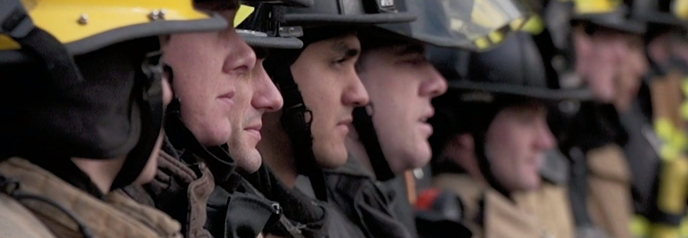

Executive Board Roles and Responsibilities
Chad Blashill, 10th District Representative
Jeff Wainwright, 9th District Representative

Slide 2
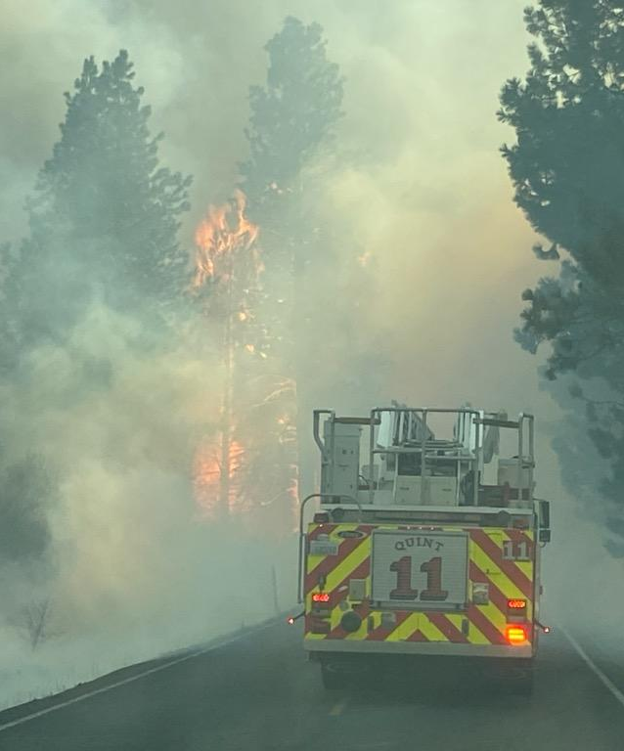
Objectives
Governance and Make-Up
Executive Board Position Definitions
Responsibilities Breakdown
Communicating effectively

Slide 3

Governance of Your Local and E-Board
Constitution and Bylaws
Clear outline of the structure
Defined responsibilities
How these members are elected or appointed
What authorities do they have?
Pay?
Who do they report to?

Slide 4
Constitution and Bylaws Specifics
Who is defined as your executive board?
President, Vice President(s), Secretary / Treasurer, At-Large Board positions
Typically, not stewards, Sergeant at Arms, Liaisons
Who can run for office?
Clear definitions of the terms, election periods, etc.
Duties/Responsibilities that are clear and defined, but not “too” limiting.
There are other ways to set limitations on specific authorities and procedures.

Slide 5
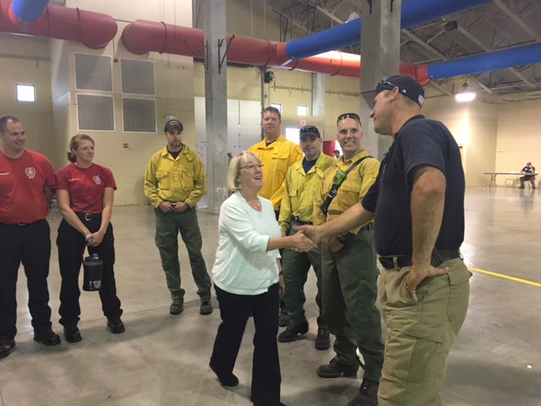
Local President
Is the face of the Local
Manage the Local
Run Local Meetings
Create Meeting Agendas
Stand up Committees
Lead Negotiator
Build Relationships
Labor and Management

Slide 6
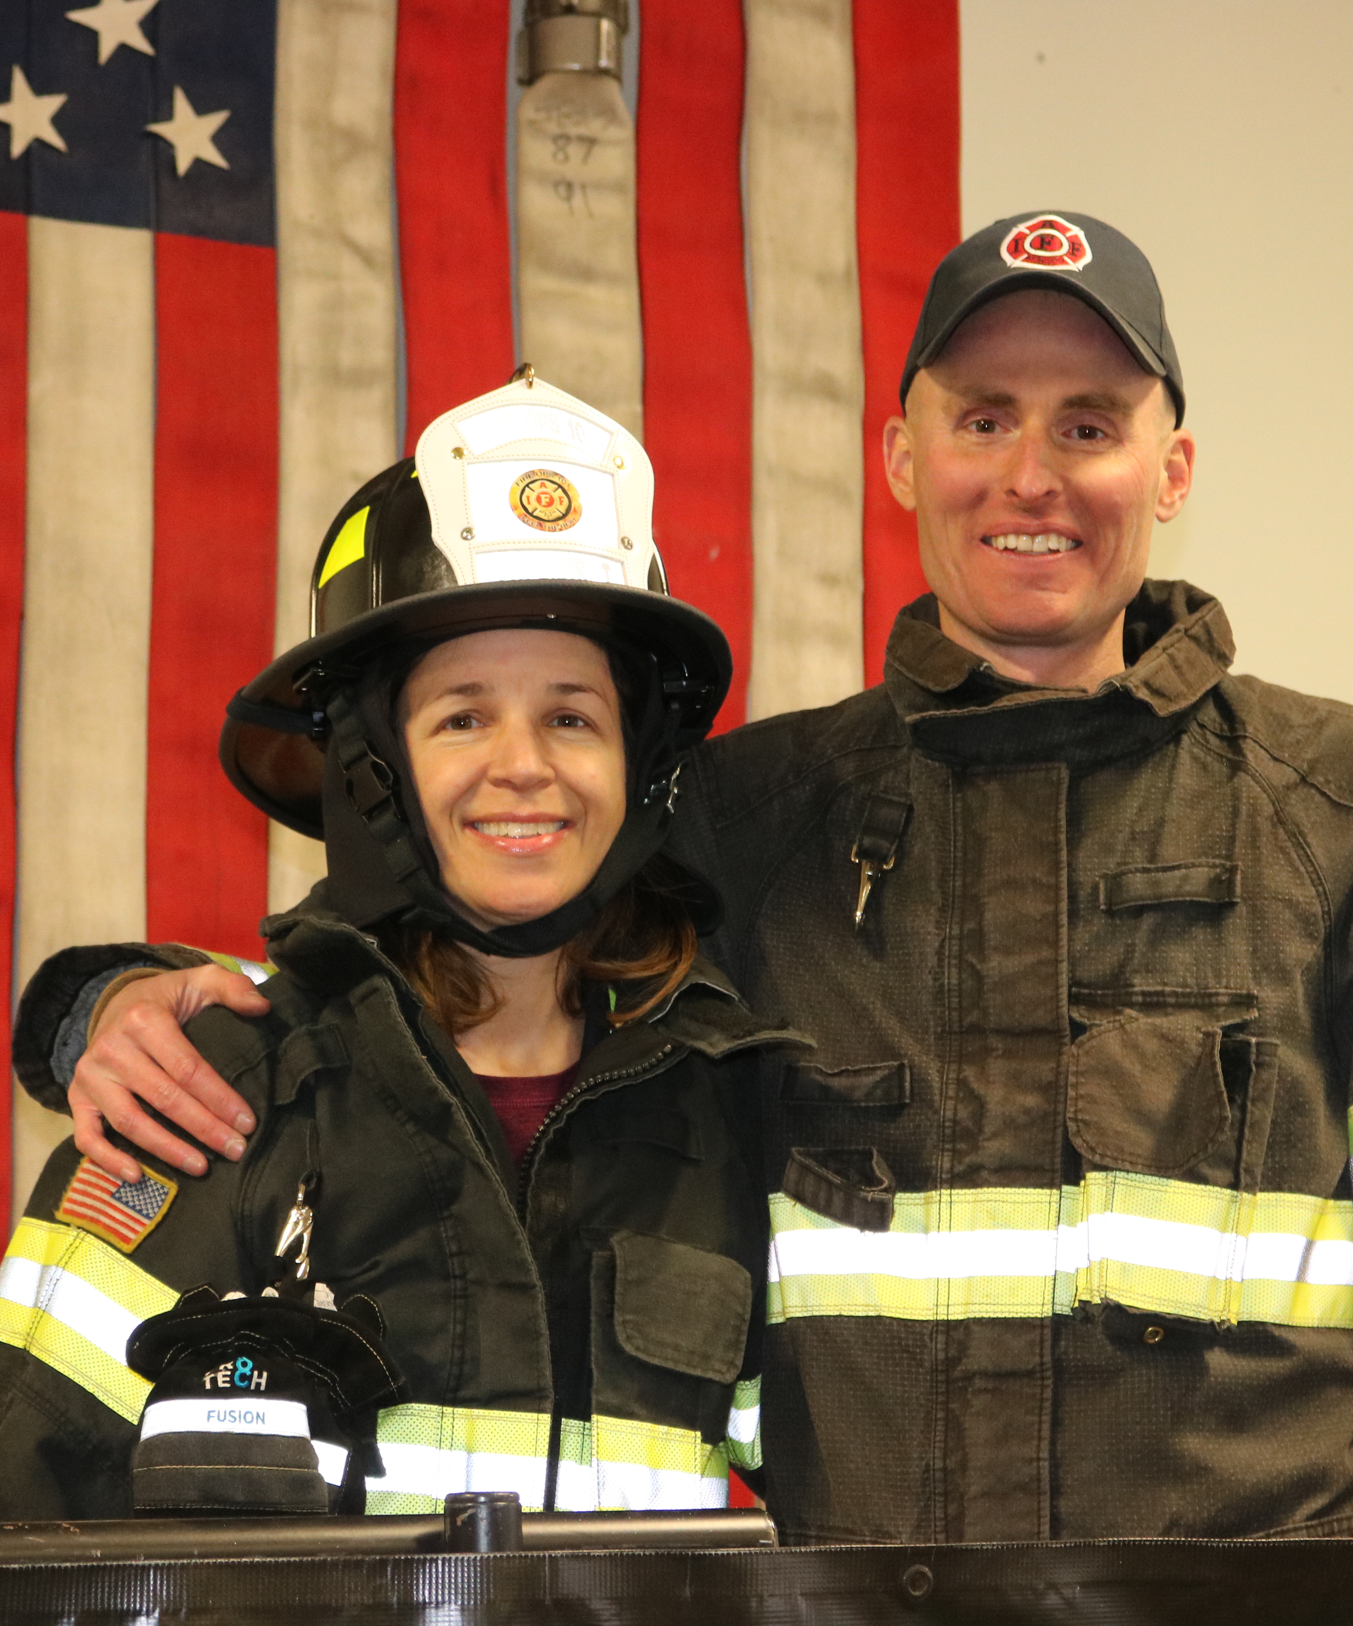
Local President Meeting Responsibilities
Create the Agenda
Understand Meeting Procedure
What rules does your local follow?
Run the regular Local Meeting
Keep meetings as short a possible
Allow for all business to be completed
It’s a business meeting, not a coffee table conversation!

Slide 7
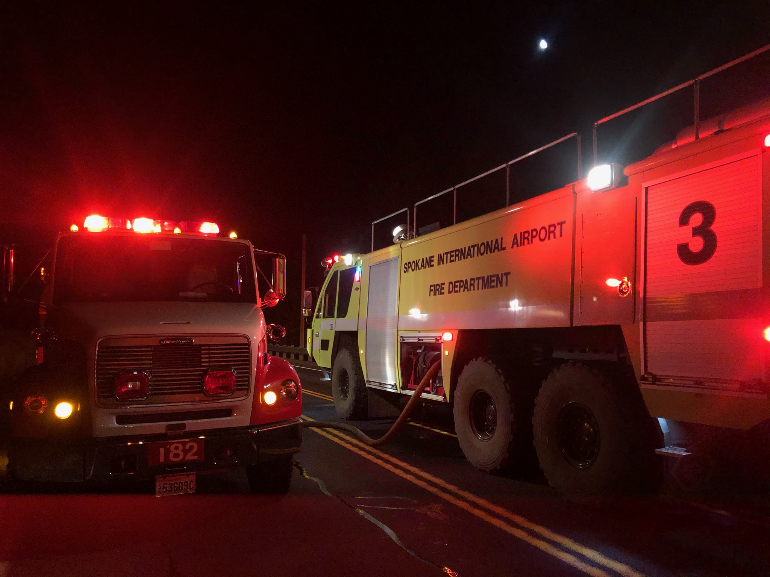
Local President - Managing the Local
Stands up Committees as needed
- Co-Chairs all committees
Communicates internally and externally
Discipline/Investigations
Negotiations/CBA
Ensure secession planning is addressed

Slide 8
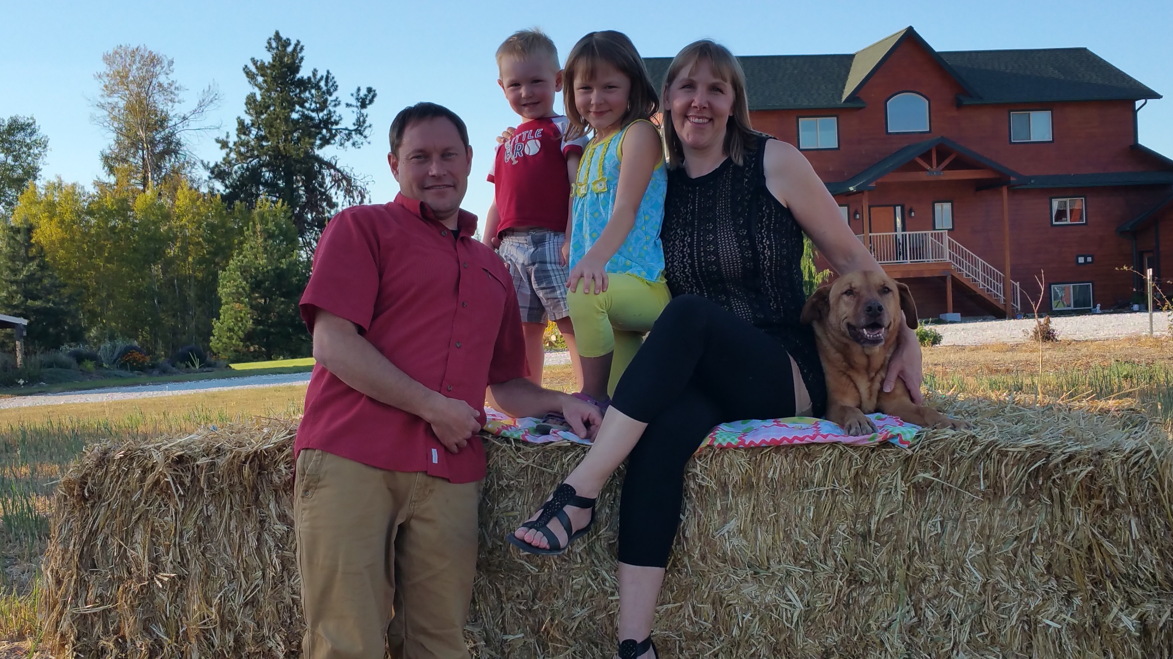
Local President - Communications
Public Relation
- Interfacing with media
- Communicating with the Public
- CLC and Local Labor Groups
Internal Communications
- Local Members
- Local Retirees
External Communication
- Elected Officials
- Administration
- Community Leaders
- Press
- State District Representative
- 7th District Vice President

Slide 9
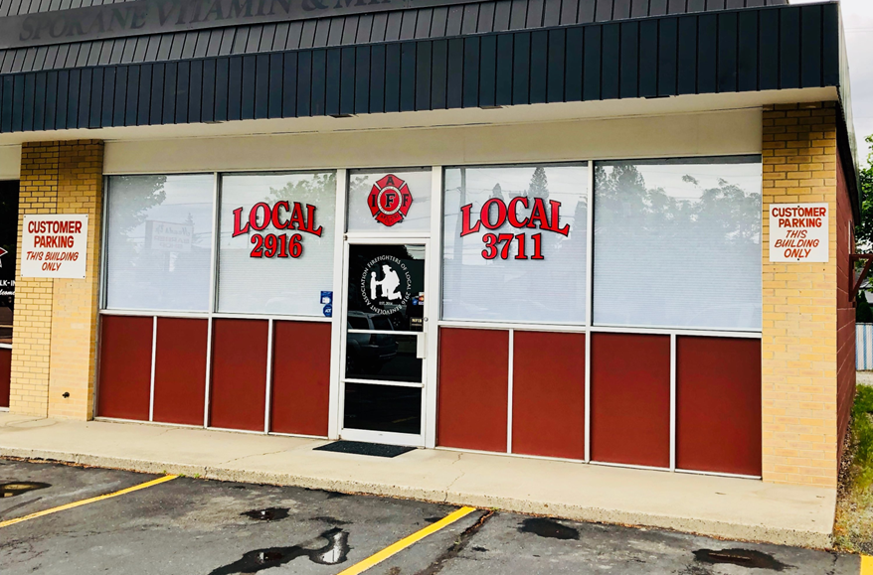
Secretary/Treasurer Responsibilities
Meeting Minutes
Opening the Locals Mail
Ensures all records are kept
Creates and manages the Locals Budget
Pays the bills
- Affiliate Per-Capita Payments (WSCFF & IAFF)
- Loans/Mortgage
Local Member Roster Updates
Local Taxes & Accounting (Payroll, IRS 990)
Real Property Management
Events Booking (Registration & Lodging)

Slide 10
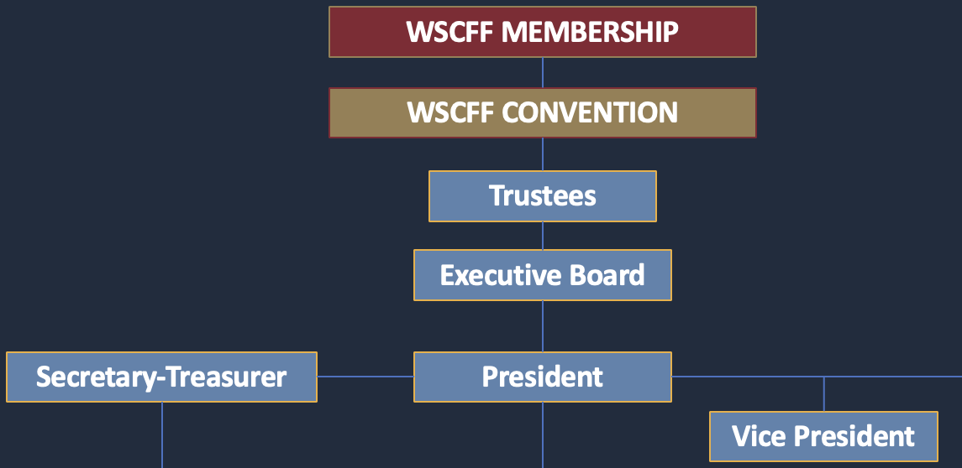
Vice President Responsibilities
Political Action Chair
Public Relations Chair
Grievance Committee Chair
More than one?
Assists the President as determined and shall fill in when the President is unavailable.

Slide 11
Executive Board Members At-Large
They make up the rest of your “standing” executive board.
Balance the voting of the Principal Officers.
Odd vs. Even Numbers
At-Large positions or specific to the bargaining unit.
Varying job responsibilities as assigned or “volun-told”.
Defined Terms in the bylaws.

Slide 12
E-Board Responsibilities Examples
Internal Auditor
Public Relations
Union Apparel
Healthcare Lead
Retiree services
C&B Review and lead
Comparable Data
Discipline/investigations
Political Action

Slide 13

Other Roles and Players
Sergeant at Arms
The “muscle” of a union meeting
Chair of elections committee
Trustees
Shift or Station Stewards
Specific to a group of members
Shifts, Stations, Ranks, etc.
Report to the executive board with information gathered
Report out to their group with information received

Slide 14
Other Roles and Players Cont.
Use these members as if they were the “executive board”.
Be transparent and make sure the message given is consistent.
Give them tasks, as they are typically closer with a specific group of people.
They will probably be in leadership positions in your local in the future.

Slide 15
Strategic Planning and Mentorship
Set goals for the local
Financial
Consistent Organizational updates
Political Involvement
Build a road map to achieve these goals
Policies
Find and mentor your replacement

Slide 16
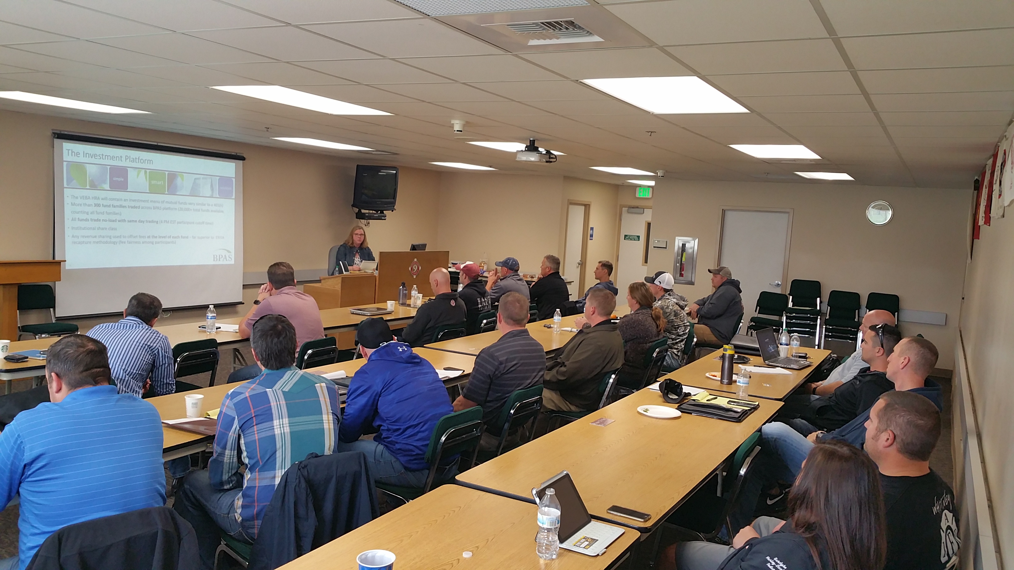
Education is Crucial
Most important form of communication you can do
Keeps your members engaged
Will ultimately give you more time
CONTRIBUTE towards their education, don’t CORRECT them.

Slide 17
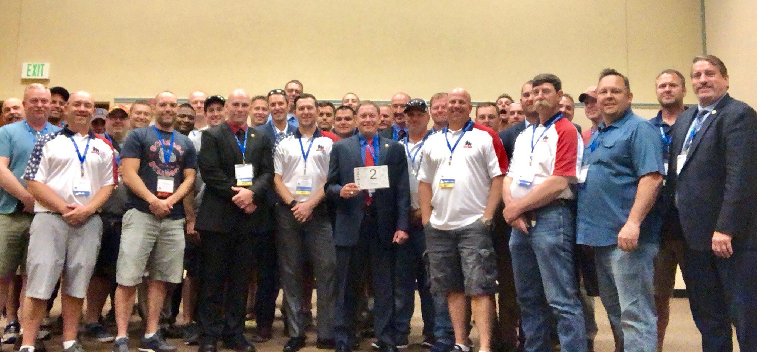
Events Communication
The most effective form of communication is in Person
Increase frequency leading into events
Have your shit tight!

Slide 18

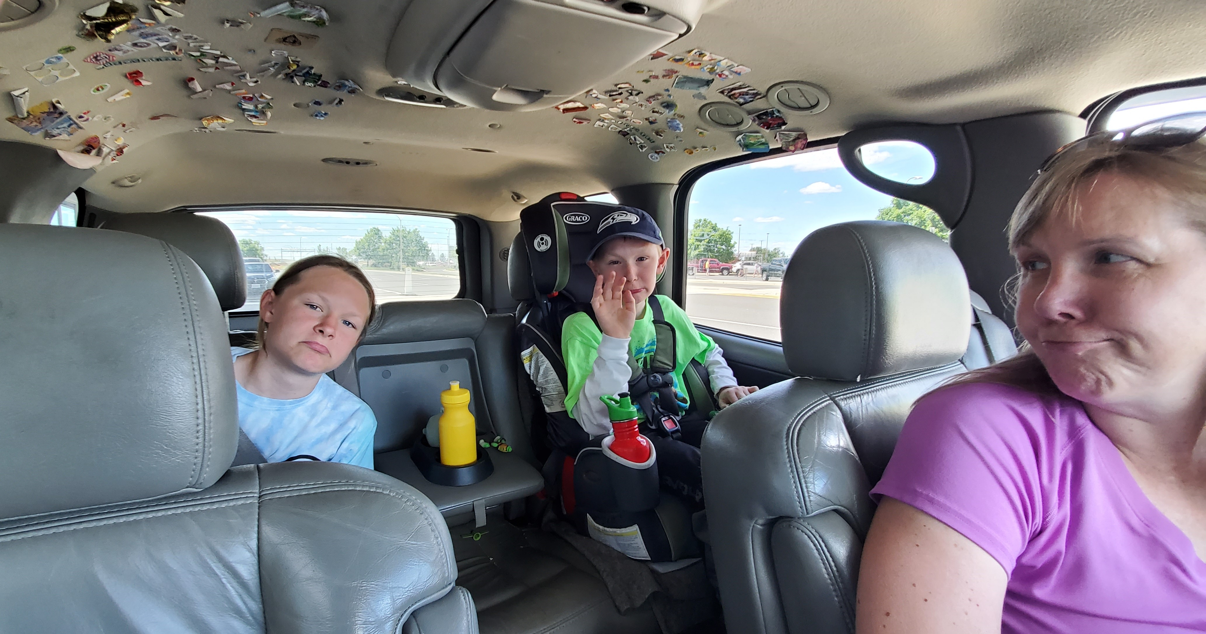
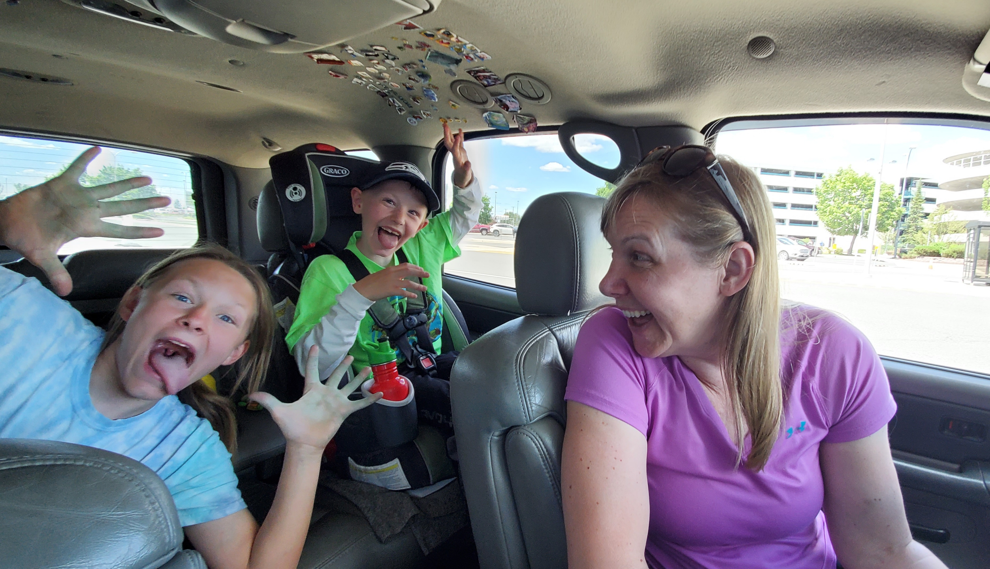
Family Support

Slide 19
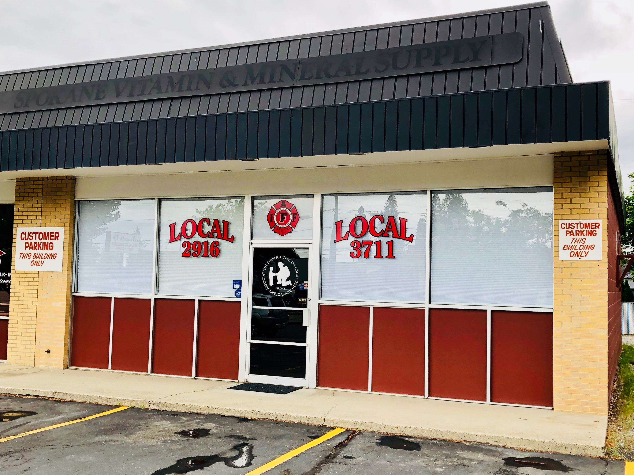
Local Union Support
Support of your Local is key
If you are in local leadership exercise your mentoring process and hand over the reins
Again, Do Not Forget them

Slide 20
Summary
Stay Organized
Bylaws should be your primary guidelines
Continuous Education
Successorship plan
Use your resources!

Slide 21
Thank you!
Questions?
Chad Blashill, 10th District Representative
10thdist@wscff.org
Jeff Wainwright, 9th District Representative
9thdist@wscff.org

