Slide 1

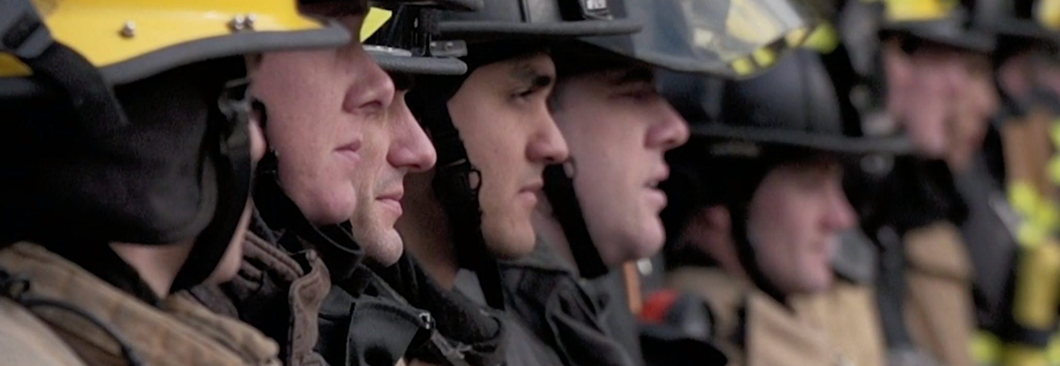

Duty of Fair Representation
Ricky Walsh, IAFF 7th District DVP
Tim Hoover, WSCFF 6th District Rep.

Slide 2
Duty of Fair Representation (DFR)
Union officers rarely face legal action from employers.
But they CAN face legal claims from their own members.
DFR claims usually arise when members believe:
• The union ignored their grievance
• The union treated them unfairly
• The union favored another member, or the chief

Slide 3
What is Duty of Fair Representation
DFR is the legal obligation requiring a union to represent ALL employees in the bargaining unit fairly.
This includes:
• Members
• Non-members
The union represents the bargaining unit — not individuals.

Slide 4
Legal Standard
A union violates the Duty of Fair Representation if its conduct is:
• Arbitrary
• Discriminatory
• In Bad Faith
If none of these are present, the union usually prevails.

Slide 5
Arbitrary Conduct
A union may violate DFR if it acts arbitrarily.
Examples:
• No investigation
• Ignoring evidence
• Missing grievance timelines
• Failure to communicate
Key question: Was the decision rational?

Slide 6
Discrimination
Discrimination occurs when members are treated differently because of:
• Race
• Gender
• Religion
• Internal union politics
• Personal relationships

Slide 7
Bad Faith
Bad faith occurs when union actions involve:
• Personal hostility
• Retaliation
• Dishonesty
• Intentional sabotage of a grievance

Slide 8
What DFR Does NOT Require
The union is NOT required to:
• Take every grievance to arbitration
• Win every case
• Agree with every member
• Pursue weak grievances
• Spend union resources on hopeless cases
The union has discretion.

Slide 9
When DFR Applies
DFR applies when the union exercises exclusive representation authority.
Examples:
• Grievance handling
• Contract negotiations
• Contract interpretation
• Discipline representation
• Settlement decisions

Slide 10
Who Can Create DFR Liability
DFR liability can arise from actions of:
• Local union officers
• Shop stewards
• Grievance committees
• Negotiating teams
• Anyone acting on behalf of the union

Slide 11
Most Common Source of DFR Claims
The number one source of DFR complaints is grievance handling.
Members often claim:
• The union ignored their grievance
• The union failed to investigate
• The union missed deadlines
• The union dropped the case unfairly

Slide 12
Non-Grievance Risk Areas
Non-Grievance DFR issues:
• Discipline cases
• Promotional disputes
• Seniority conflicts
• Specialty assignments
• Overtime distribution
• Conflicts between members

Slide 13
Representing the Bargaining Unit
Union leadership must consider what is best for the entire bargaining unit.
A grievance that benefits one firefighter but harms the bargaining unit may not be pursued.

Slide 14
Documentation Protects the Union
One of the best defenses to a DFR claim is documentation.
Document:
• Investigations
• Witness interviews
• Meeting notes
• Decision making
• Communication with the member

Slide 15
Reducing DFR Liability
Best practices:
• Treat all bargaining unit members equally
• Conduct reasonable investigations
• Document decisions
• Follow bylaws and the contract
• Focus on the interests of the bargaining unit

Slide 16
When in Doubt
If a grievance or situation feels complicated:
Contact:
IAFF DVP
District Representative
WSCFF leadership
Labor counsel if needed

Slide 17
Case Study #1
A firefighter receives discipline.
The union investigates and determines the contract likely supports management.
The union decides not to pursue arbitration.
Discussion:
Did the union violate DFR?

Slide 18
Case Study #2
Two firefighters dispute overtime assignments.
The contract language is unclear.
The union supports one interpretation.
Discussion:
What steps should the union take to avoid a DFR claim?

Slide 19
Key Takeaways
Unions are required to:
• Act fairly
• Act rationally
• Avoid discrimination
• Avoid bad faith decision making
Balance individual concerns with the interests of the bargaining unit.

Slide 20
Questions?

