Slide 1

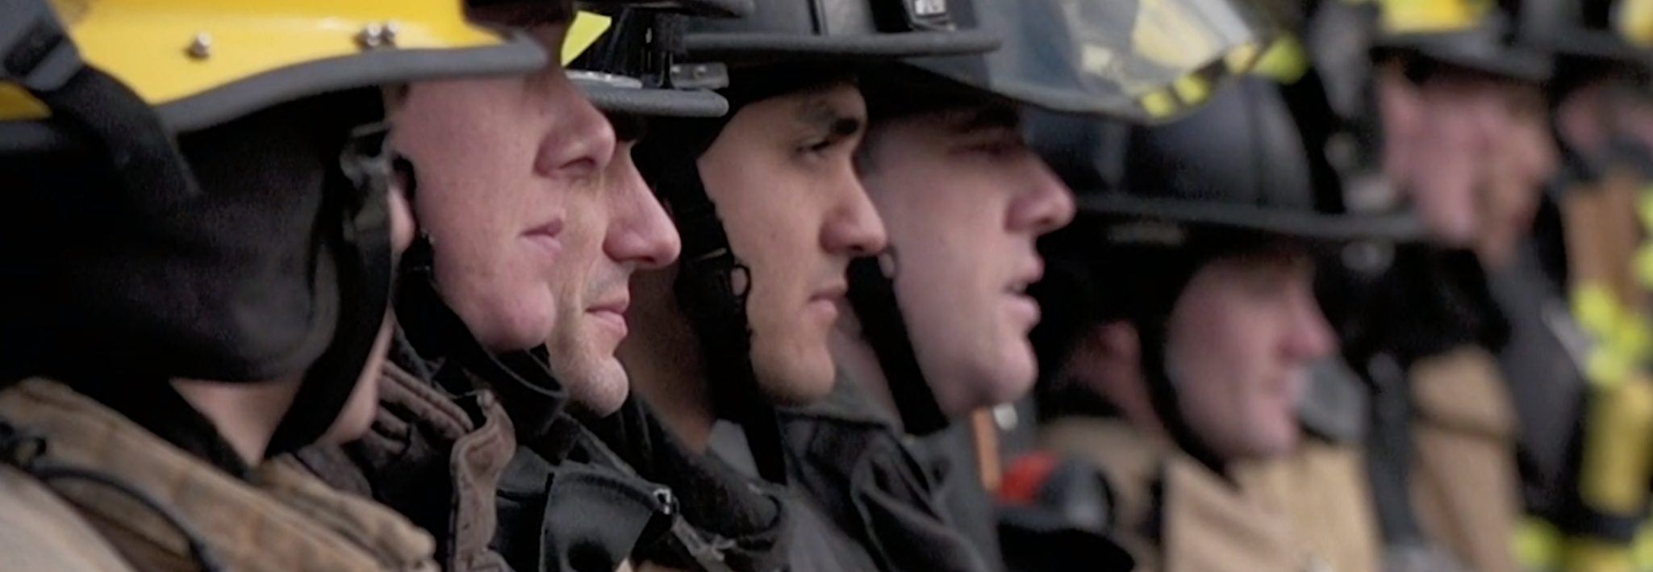

Discipline
Ricky Walsh, IAFF 7th District DVP
Tim Hoover, WSCFF 6th District Rep.

Slide 2
Define a Grievance
What is a grievance?
Give examples

Slide 3
Define Just Cause
Labor arbitrator Carroll Daughtery developed the widely used Seven Tests of Just Cause used in arbitration.
The seven tests of Just Cause are:
Notice- Did the employee know the rule and consequences?
Reasonable Rule or Order- Is the rule reasonably related to the job?
Investigation- Did management investigate before disciplining?
Fair Investigation- Wasa the investigation fair and objective?
Proof- Is there substantial evidence of misconduct?
Equal Treatment- Are rules applied consistently to all employees?
Appropriate discipline- Is the discipline proportional to the offense?

Slide 4
Resolution
The resolution must meet the just cause provision.
What does that mean?

Slide 5
Just Discipline
Give examples of “Just Discipline”

Slide 6
Rights
Rights that are not exercised are not rights!

