Slide 1

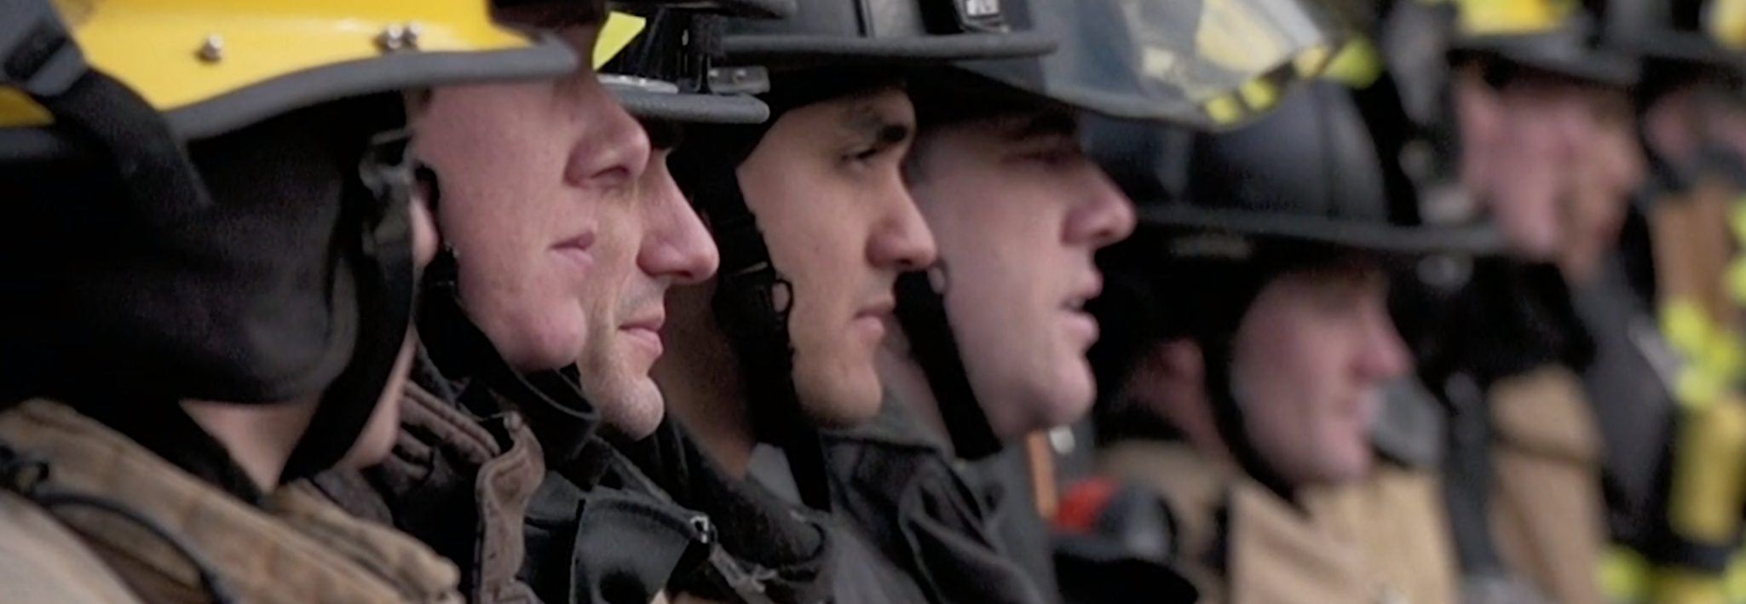

Unfair Labor Practices (ULP)
Ricky Walsh, IAFF 7th District DVP
Tim Hoover, WSCFF 6th District Rep

Slide 2
Unfair Labor Practices (ULPs)
We will cover:
Recognizing violations
Protecting bargaining rights

Slide 3
Why Union Leaders Must Understand ULPs
Union officers are often first to see violations
ULPs protect collective bargaining
ULPs can be strategic tools

Slide 4
What Is an Unfair Labor Practice?
Conduct violating collective bargaining law
Can be committed by employers or unions

Slide 5
Who Is Covered Under RCW 41.56
City and county employees
Firefighters and law enforcement
Public utility district employees
Some higher education employees
Transit workers
Certain state workers (depending on bargaining unit)
*Private Sector Firefighters covered under National Labor Relations Act (NLRA) and enforced by the National Labor Relations Board (NLRB)

Slide 6
Employer ULP Categories
Interference
Discrimination
Domination
Refusal to bargain

Slide 7
Interference
Threats about union activity
Promises of benefits
Coercive questioning
Surveillance

Slide 8
Discrimination
Punishing employees for union activity
Retaliation for grievances
Targeting union leaders

Slide 9
Weingarten Rights
Right to union representation during investigatory interviews
Employee must request representation

Slide 10
Employer Domination
Employer influences union decisions
Employer controls union leadership

Slide 11
Refusal to Bargain
Unilateral changes
Failure to provide information
Surface bargaining

Slide 12
Union ULPs
Duty of Fair Representation
Union discrimination
Union interference

Slide 13
Duty of Fair Representation
Union must not act arbitrarily
Union must not discriminate
Union must act in good faith

Slide 14
Statute of Limitations
ULP complaints typically must be filed within 6 months

Slide 15
Preparing a ULP Case
Investigate facts
Collect documents
Identify witnesses

Slide 16
ULP Investigation Checklist
What happened?
Who was involved?
When did it occur?
What evidence exists?

Slide 17
Filing a Complaint
Complaint form (on PERC website or on the NLRB website)
Create a statement of facts
Requested remedies

Slide 18
After Filing
Deficiency notice or cause of action
Hearing scheduled if case proceeds

Slide 19
ULP Hearing Process
Opening statements
Evidence
Witness testimony
Cross examination
Closing arguments

Slide 20
Possible Remedies
Cease and desist orders
Posting notices
Restore status quo
Back pay, make-whole remedy

Slide 21
Firefighter-Specific ULP Examples
Staffing changes
Schedule changes
Union retaliation
Weingarten violations

Slide 22
Grievance vs ULP
Contract violation → grievance
Labor law violation → ULP
Some situations involve both

Slide 23
Key Takeaways
Recognize violations early
Document misconduct
Protect bargaining rights

