Slide 1
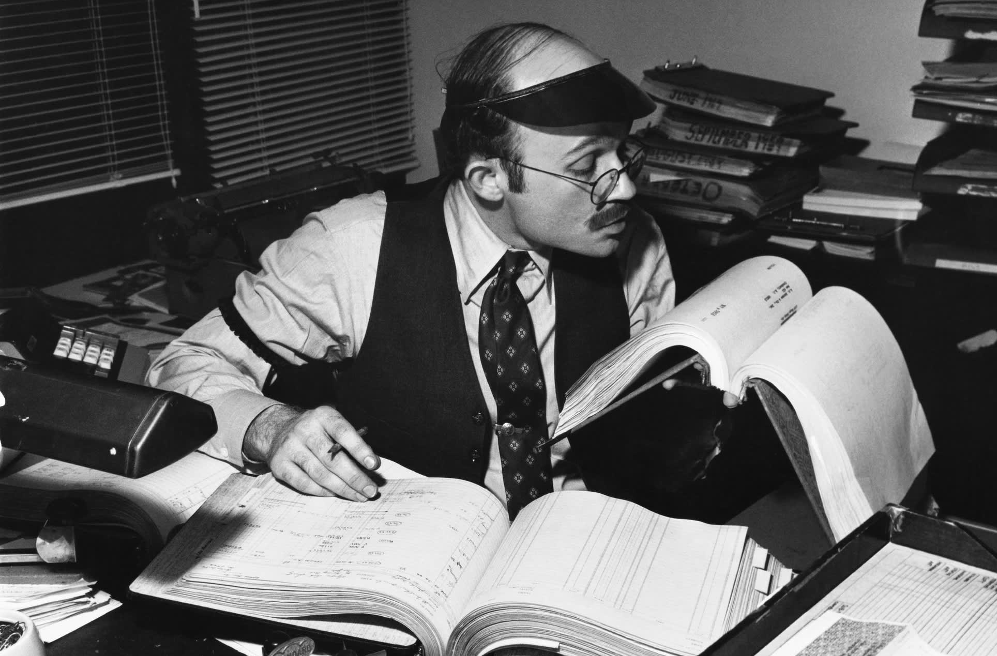
Advanced Treasurer
Bill
Dodd
Washington State
Council of Fire Fighters
2026
Notes:
There are two title slide options: One without photos (here)

Slide 2
Today’s Team
Bill Dodd
Past Secretary-Treasurer
Coeur d’Alene, ID L0710
Consultant with GST
Doug Stern
IAFF Director of GST Operations
Cincinnati, Ohio Local 48

Slide 3
Learning Objectives
Tax Filings
Fraud Protection/Audits
Sub-Contractor vs Employee
Budgeting
Investment Options
Bonding Amounts

Slide 4






Secretary Duties
Secretary
Custody of all documents
Minutes
Seal of the local
Correspondence
Maintain Official List of Members
Maintain records

Slide 5






Treasurer Duties
Investments
Treasurer
Audits
Reports to Membership,
Board, and IAFF

Slide 6
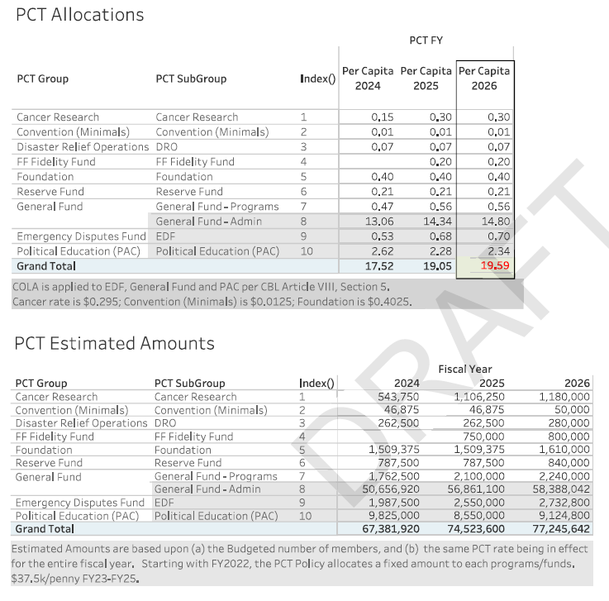
Per Capita Chart

Slide 7

Fiduciary Responsibility
Applies to ALL Union Officers
Legal Obligation
Duty to Make Decisions in the Best Interest of the Union
Duty to Inquire/Ask Questions
Intro to Fiduciary Responsibilities Class
  Online class
  Certificate provided
  Invoice
Link to IAFF
Intro to Fiduciary Responsibilities Class

Slide 8
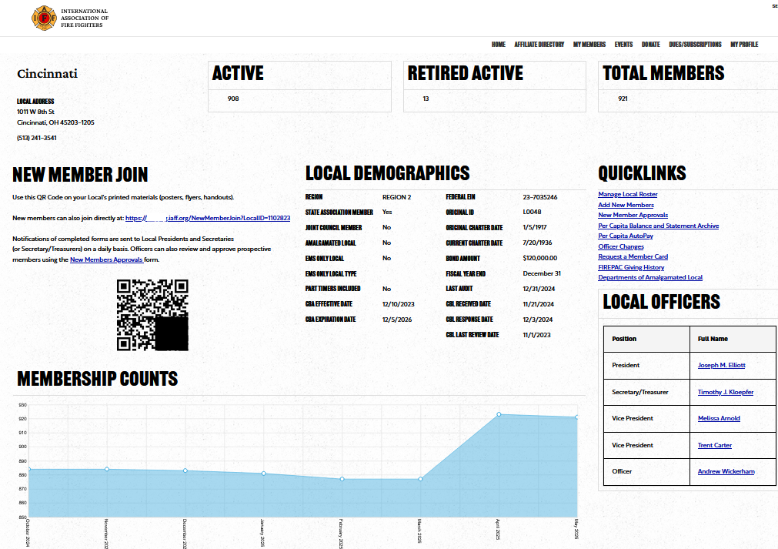
Membership Dashboard

Slide 9
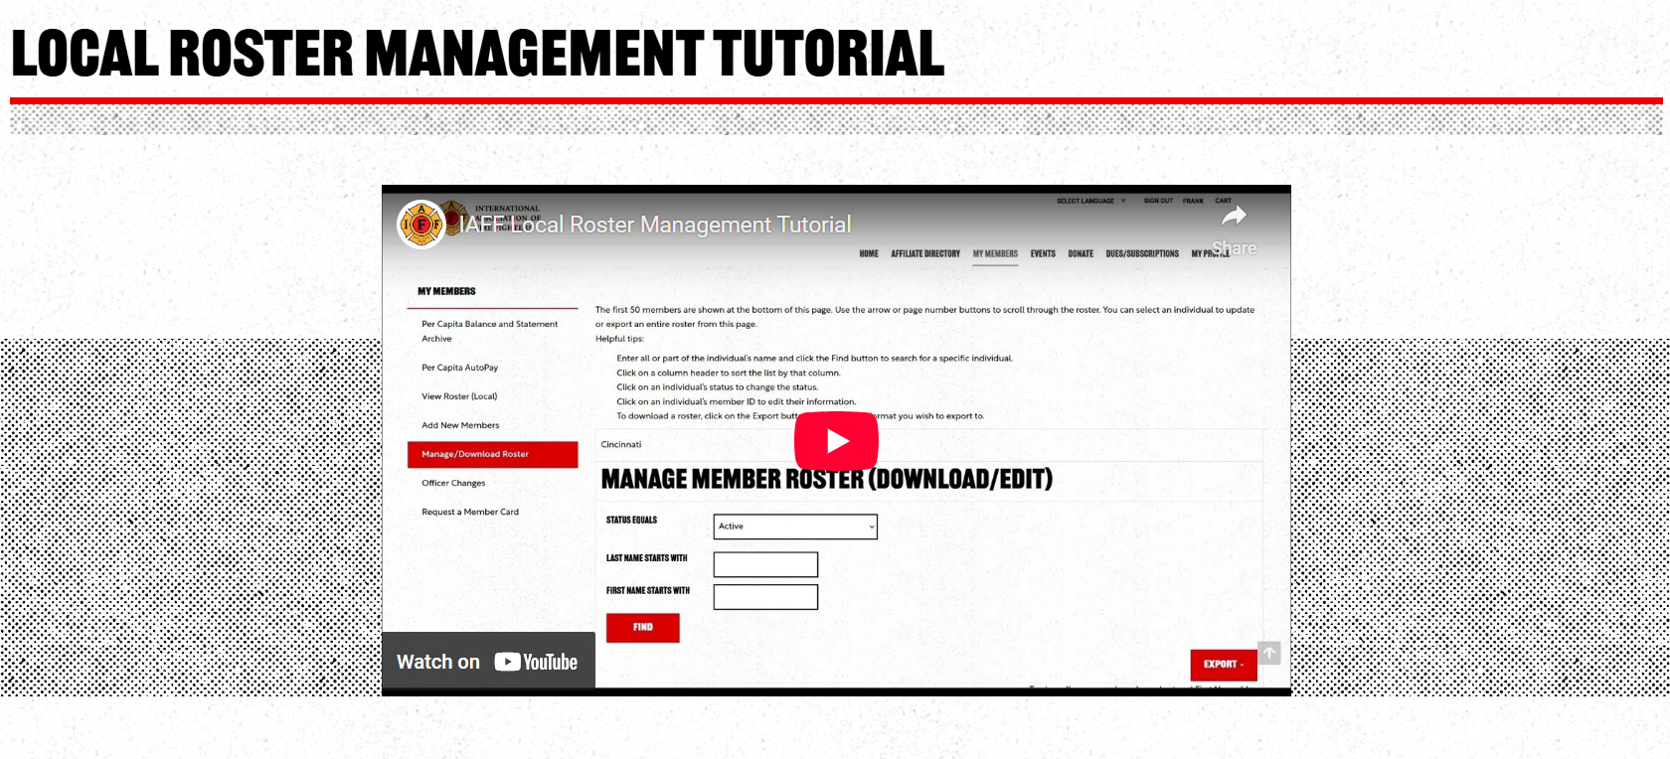

Roster Updates

Slide 10
Financial Policies

Slide 11
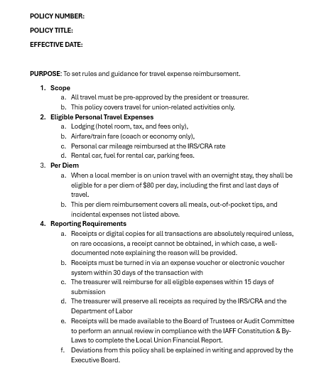

Policies
Best Practice
Approved by Local Board
Adopted by Membership
Sets Expectations and Rules
IN WRITING
GST Office can assist and advise

Slide 12
Financial Policies
Budget
Expense Reimbursement
Travel
Credit Card Usage
Document Retention
Investments

Slide 13

Petty Cash
What are the legitimate purposes for a petty cash account?
How much should you have on hand?
Safeguards on petty cash accounts.
All deposits into and withdrawals from the petty cash box should be contemporaneously described on a ledger.

Slide 14

Reimbursement or Union Credit Card

Slide 15
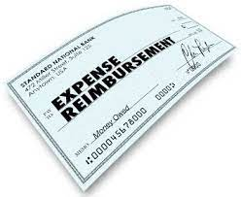
Expense Reimbursement
How do you track expenses?
  Voucher
  Receipts
How often do you reimburse?
Where is the list of what is reimbursable?
Who authorizes expenses?
Do you use travel per diem or reimbursements

Slide 16
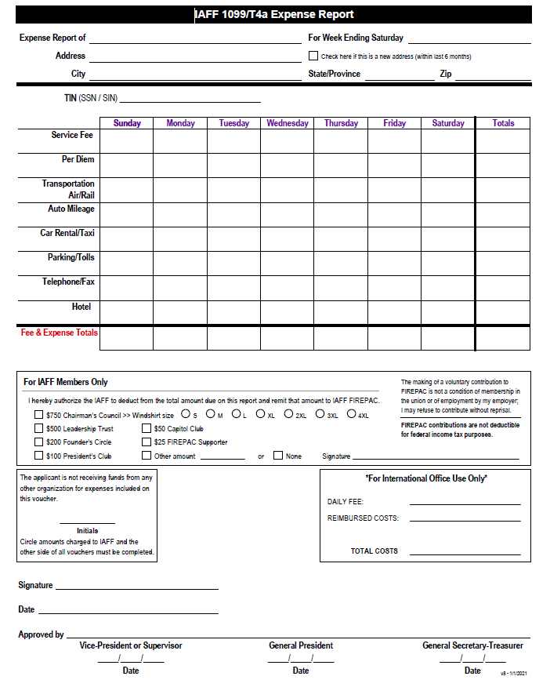
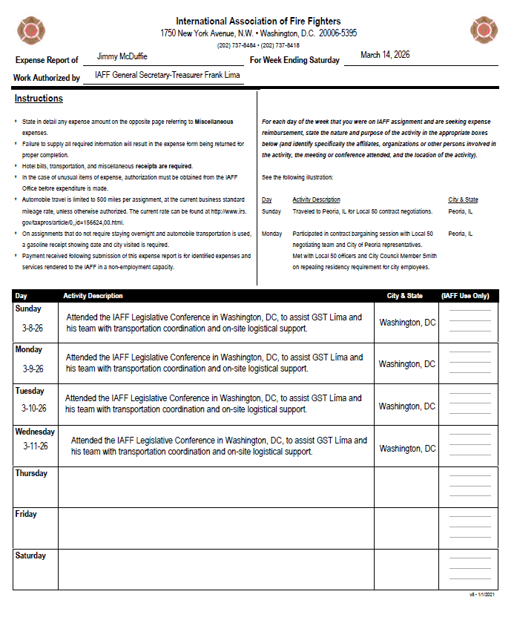
Expense Reimbursement

Slide 17

Credit Cards
Expenditure maximums.
The need for monthly auditing of credit cards.
The most commonly-occurring credit card problem – a union officer, often the treasurer, who uses the card for personal purposes and then promptly repays the organization.
Which members of the board should have union credit cards?

Slide 18


Debit Cards
STRICTLY
PROHIBIT
ATM
USAGE!

Slide 19
US
Tax Filings
Notes:
The section breaks can feature any colors from the IAFF primary palette – IAFF Red and IAFF Blue are preferrable, and are preset in this template.

Slide 20

Year End Responsibilities
IAFF Audit
990 Tax Return
State Tax Return
Payroll W2’s and W3, 941, 940, State forms
1099s and 1096
DOL Forms (Federal Firefighters only)

Slide 21
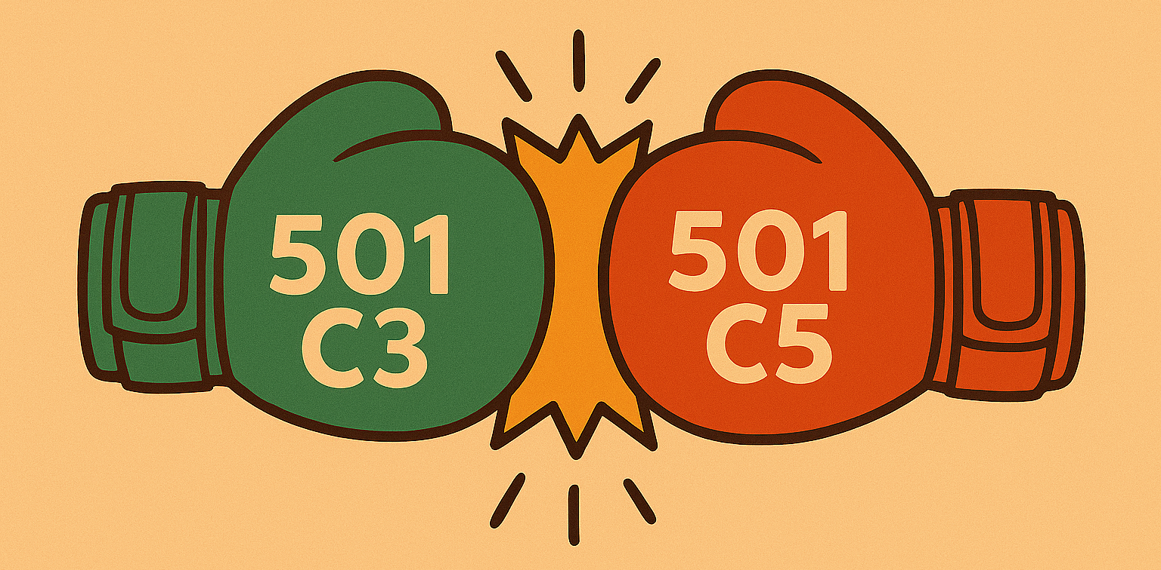
Tax-Exempt Status

Slide 22

Tax Exempt Status
Two Steps to Obtain Status
  Get an EIN
  File for Exemption
    File a 1024 or
    Join the IAFF Group Exemption
Failure to file a tax return for three consecutive years = Revocation
  Income from a trade or business, regularly carried on, that is not substantially related to your exempt purpose

Slide 23
Tax Exempt and Taxes
Exempt from Federal income taxes
Sales tax still applies
Unrelated Business Income Tax (UBIT)
Income from a trade or business, that is regularly carried on, and that is not substantially part of your exempt purpose
Must file 990-T if your gross income is over $1,000
Corporate tax rate is 21%

Slide 24
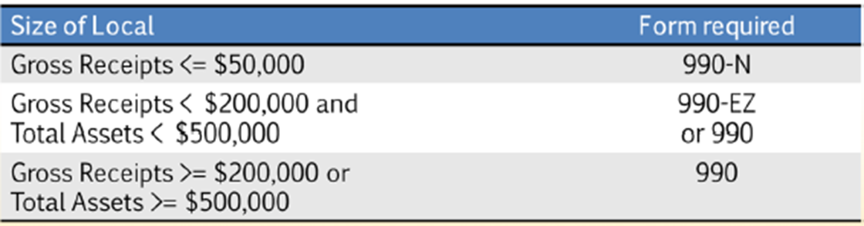
Federal Filing Requirements
All locals are required to complete a Form 990 annually and file with the IRS
The appropriate version of the form is as follows:
Filing deadline is the 15th day of the 5th month following the end of the fiscal year.
Notes:
990-EZ and 990 required to be filed electronically. Only way to do that is through a 3rd party

Slide 25
Which 990?
Gross Revenue as of 12/31/23 = $220,000 Total Assets = $100,000
IAFF dues paid in 2023 = $30,000
State dues paid in 2023 = $35,000
Total revenue for IRS = $190,000 so 990-EZ
Payments to a parent organization can be removed from income to calculate gross revenue for the form 990. If you reduce your revenue you also need to remove the amount from the expense side too.

Slide 26
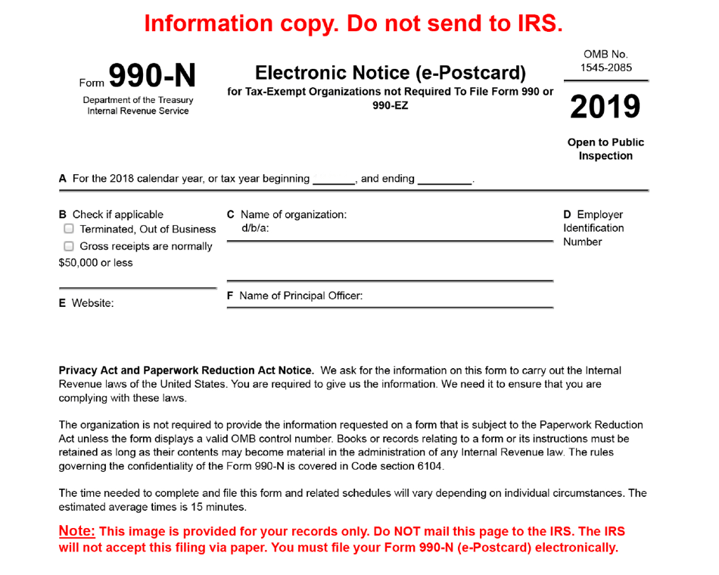
990-N
Electronic Postcard done on IRS website.
No need for a tax professional to file.

Slide 27
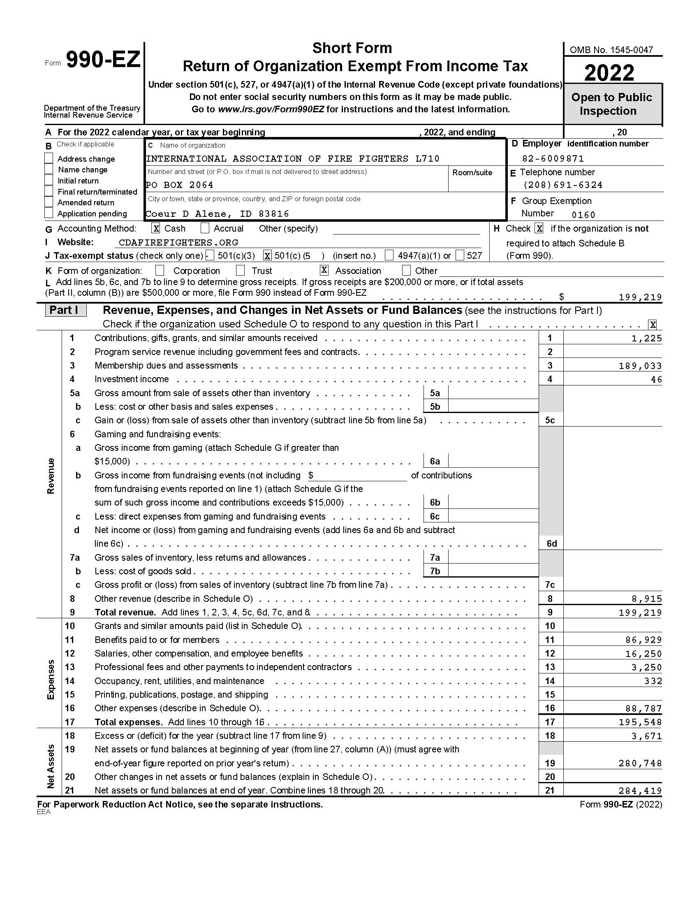
990 Income and Expense categories

Slide 28
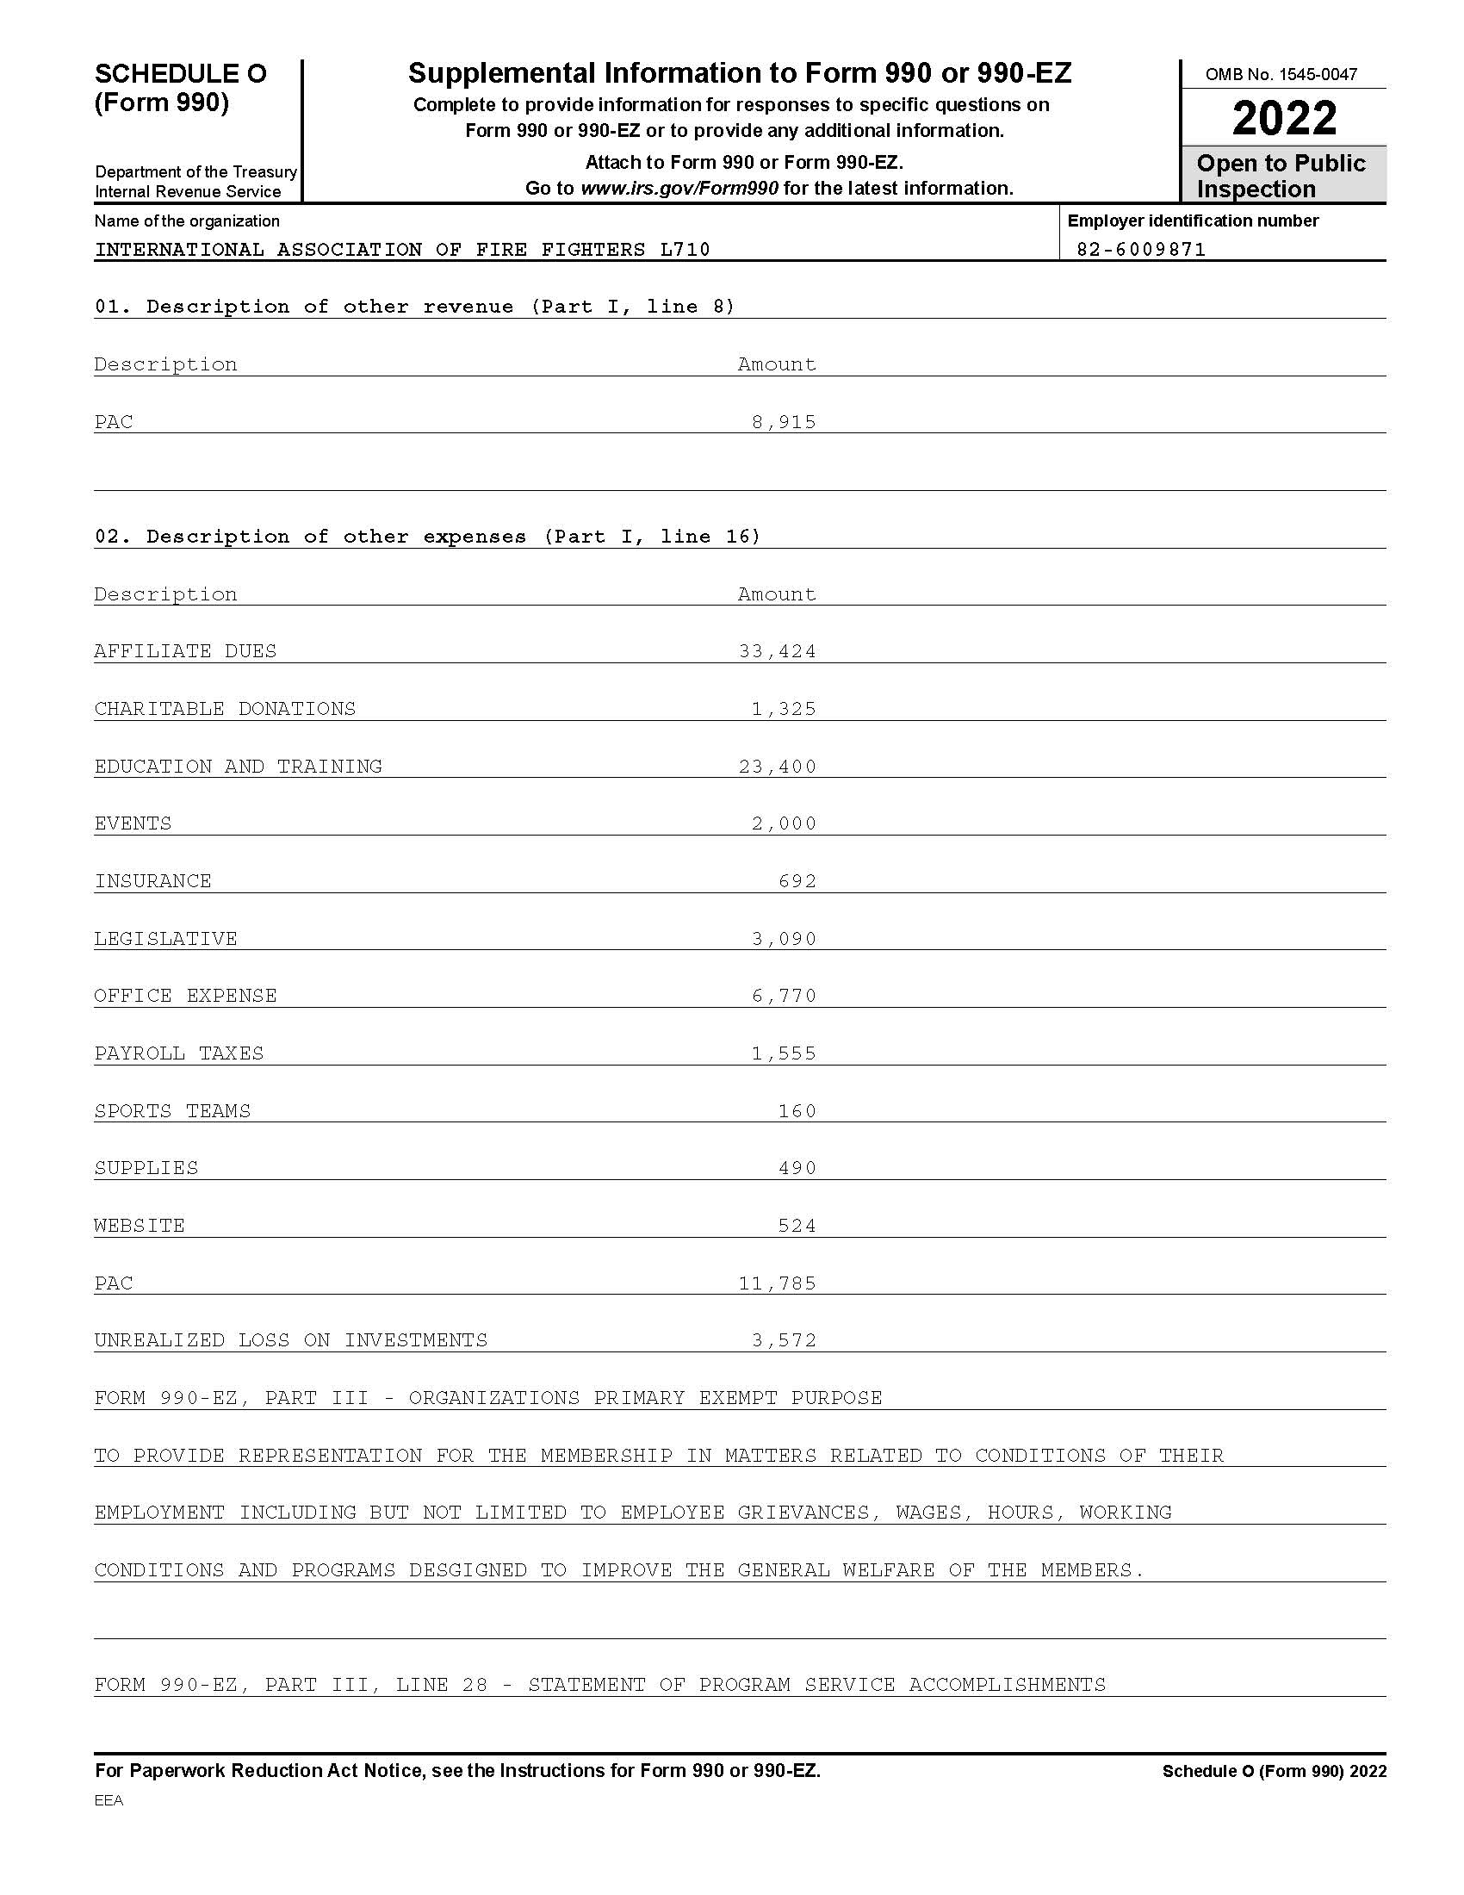
990 Income and Expense Categories

Slide 29

Lost Tax-Exempt Status
Call the GST Office
Options Exist
Do Not Hire an Accountant or Service to Reinstate Your Status

Slide 30
Federal Fire Fighters LM Reports
LM-1 Labor Organization information report
LM-2 Total annual receipts > $250,000
LM-3 Total annual receipts $10,000 - $249,000
LM-4 Total annual receipts < $10,000
DUE 90 DAYS AFTER YEAR END

Slide 31
Budgeting

Slide 32

Building your Budget
Start with your expected revenue
Determine what your fixed expenses are
IAFF/State/Labor Council dues, Payroll, Rent etc.
The remaining balance can be used for other expenses
Don’t have a negative balance on your budget

Slide 33

Budget - Transfers
Accounts for monthly transfers
Add them below Net Income

Slide 34
Budget Info to Consider
Revenue
Dues
Merch Sales
Interest
Assessments
Contributions
Expense
IAFF Per Capita ($19.59)
State/Provincial Per Cap ($12.25)
Rent
Office Supplies (Computers)
Travel
Salaries
Professional Fees (Legal/Accounting)

Slide 35
BUILD YOUR
OWN BUDGET
15 minute exercise

Slide 36
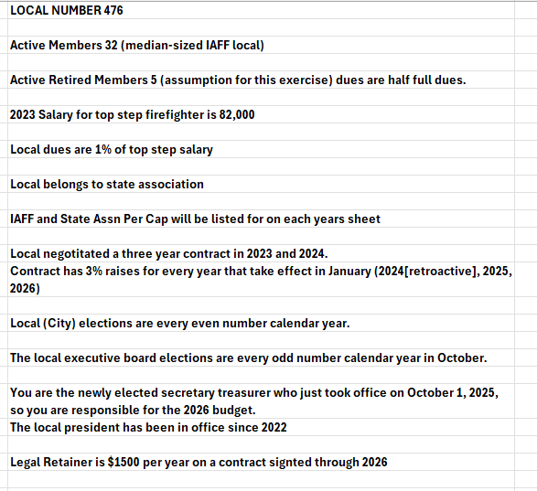
Budget for Local 476

Slide 37
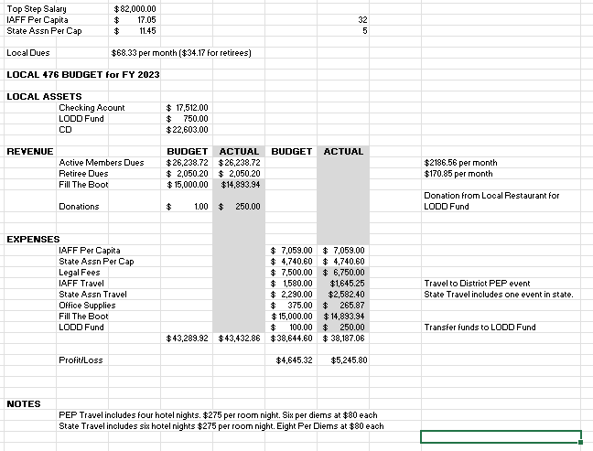
Budget 2023

Slide 38
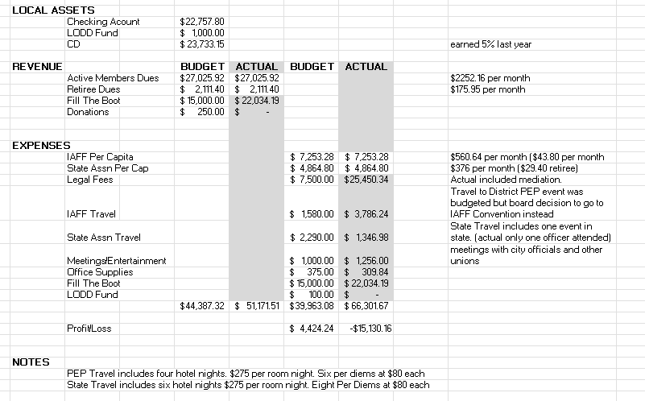
Budget 2024

Slide 39
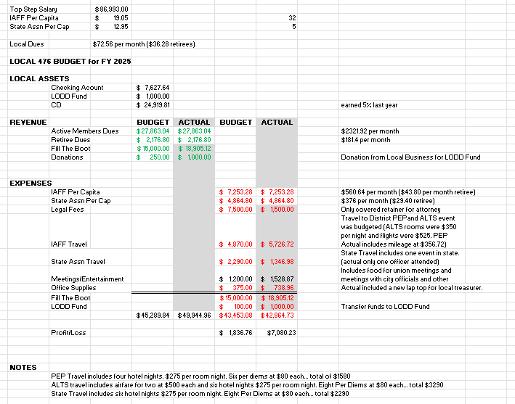
Budget 2025

Slide 40
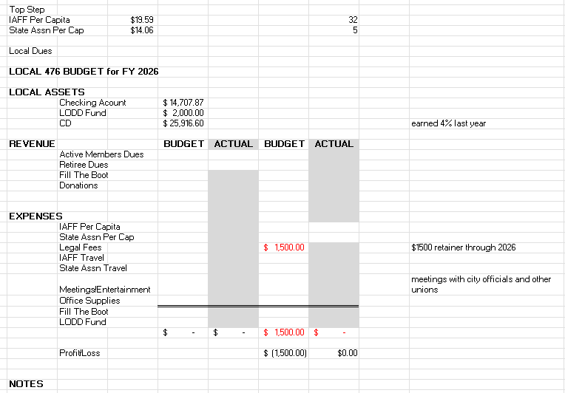
Budget 2026

Slide 41
Fraud /Audits

Slide 42

Compilations, Reviews, and Audits
A compilation is the preparation of financial statements of private entities based on information provided by the entity’s management.
A compiled financial statement represents the most basic level of service CPAs provide with respect to financial statements.
Compilation

Slide 43

Compilations, Reviews, and Audits
A review requires all of the procedures necessary for a compilation engagement, plus other procedures that enable the accountant to provide limited assurance on the financial statements. These additional requirements are inquiries of client management and analytical procedures.
Review

Slide 44

Compilations, Reviews, and Audits
An audit is the third and most extensive service. It provides the highest level of assurance on the client's financial statements, because many important audit procedures are not required for compilations or reviews.
Audit

Slide 45

How Do We Internally Review our Financials
Start with ending bank balances
Compare the Budget vs Actual P&L
Details on categories with a variance over your threshold
Should be able to tie to receipts or documents
Review the transactions on bank statements

Slide 46
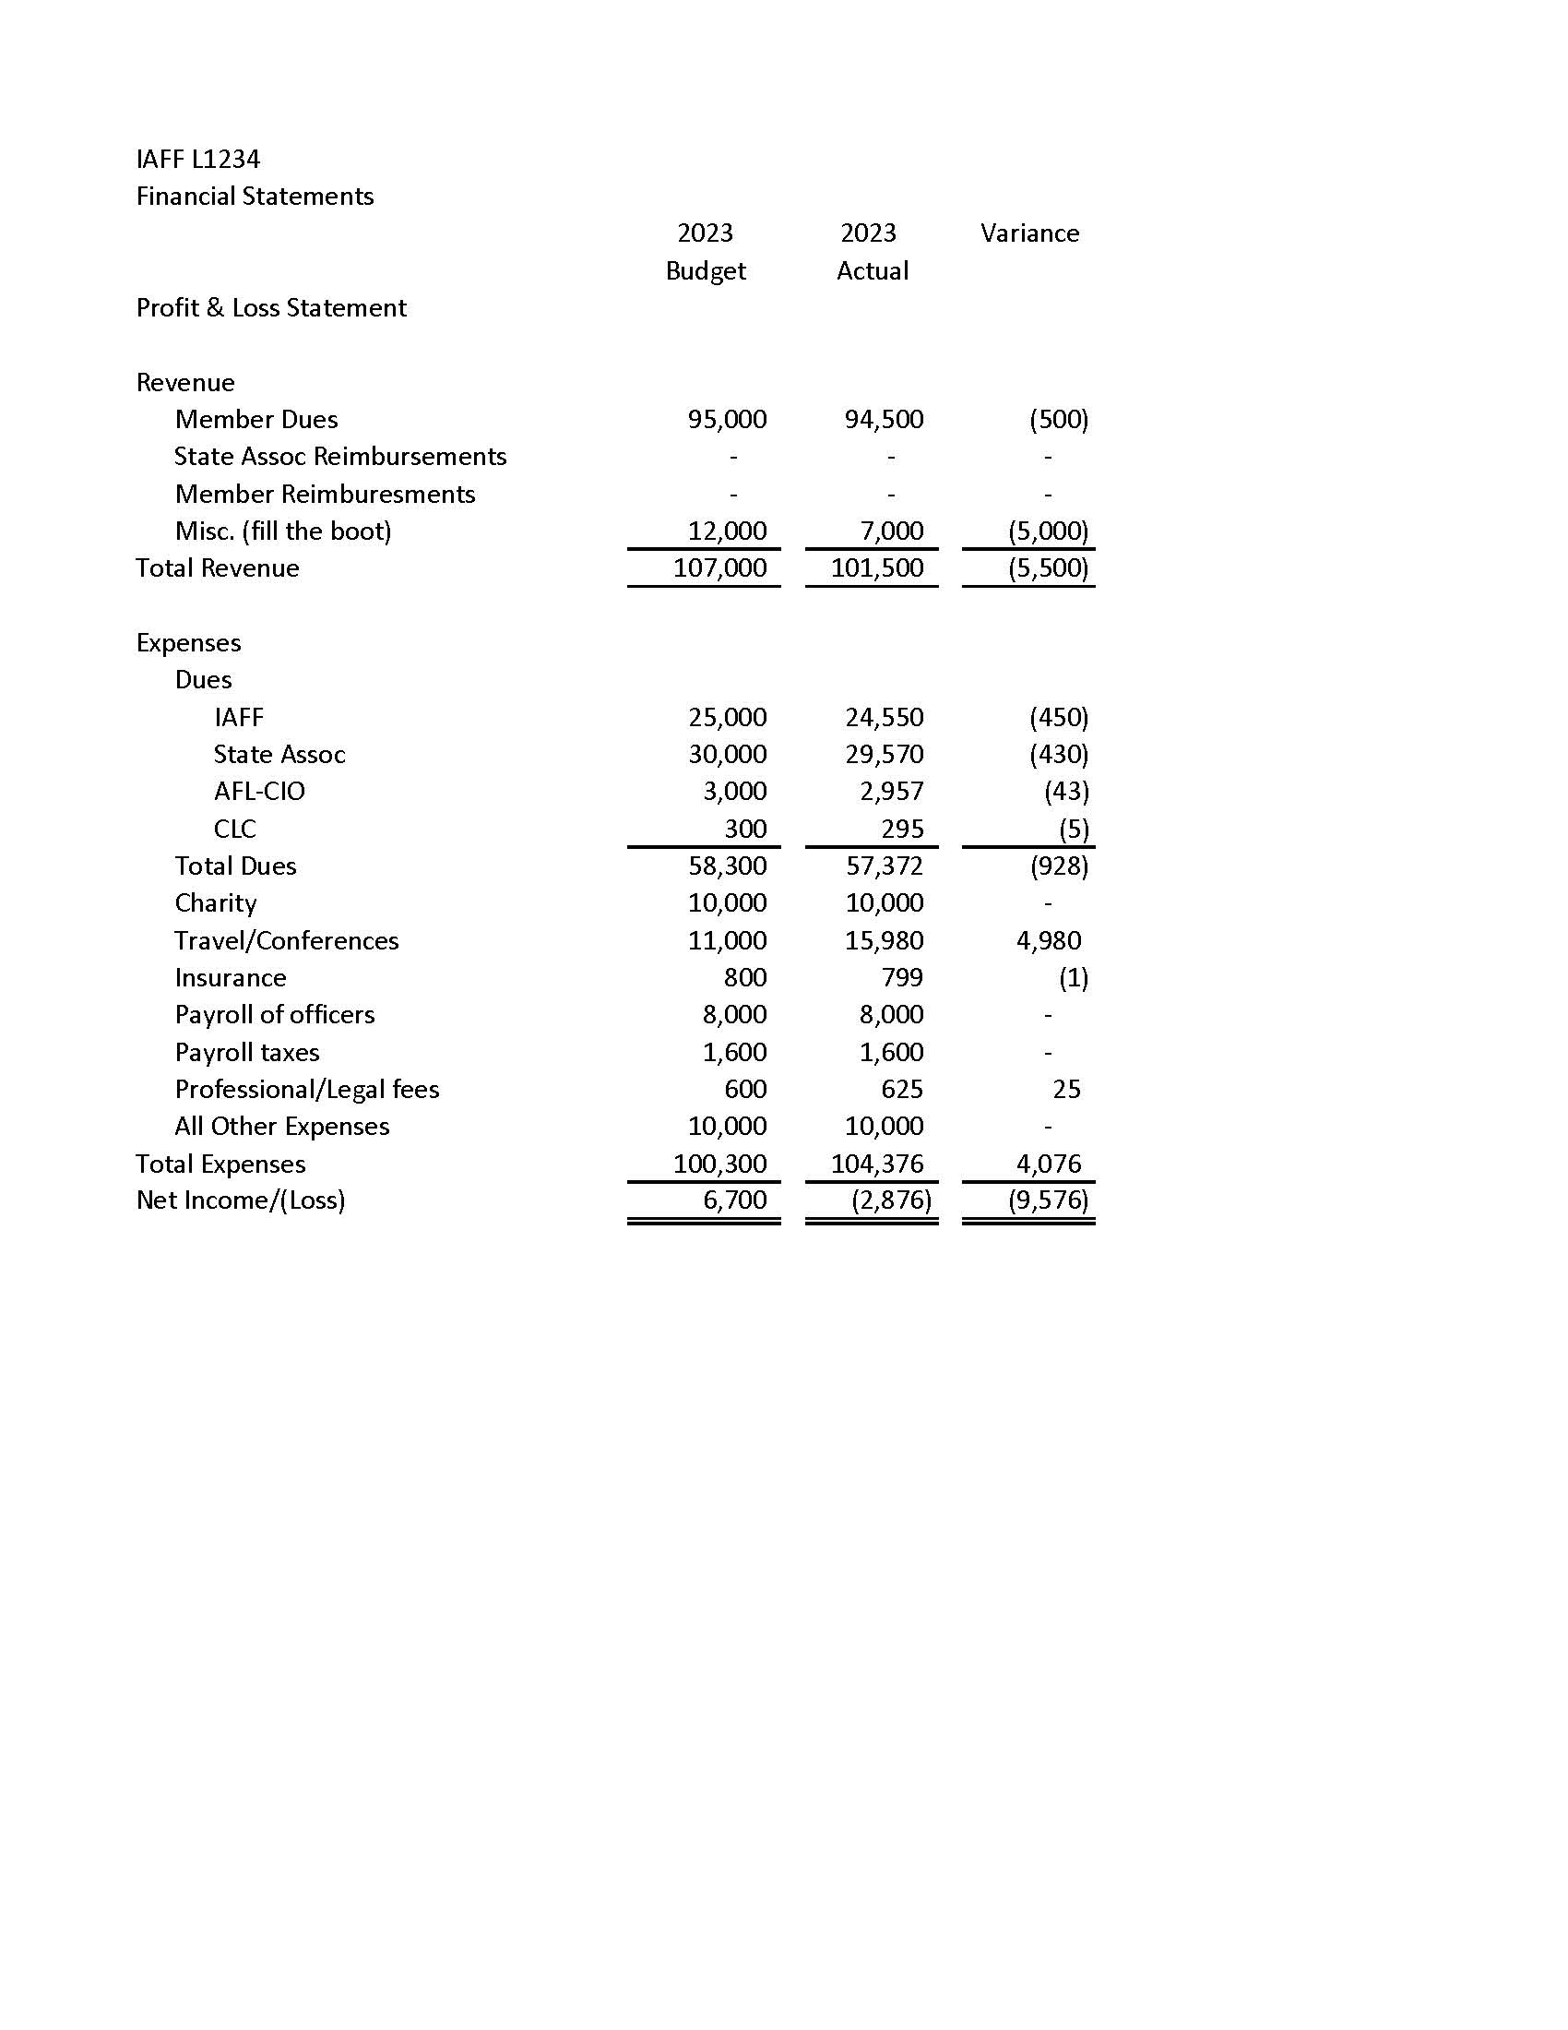
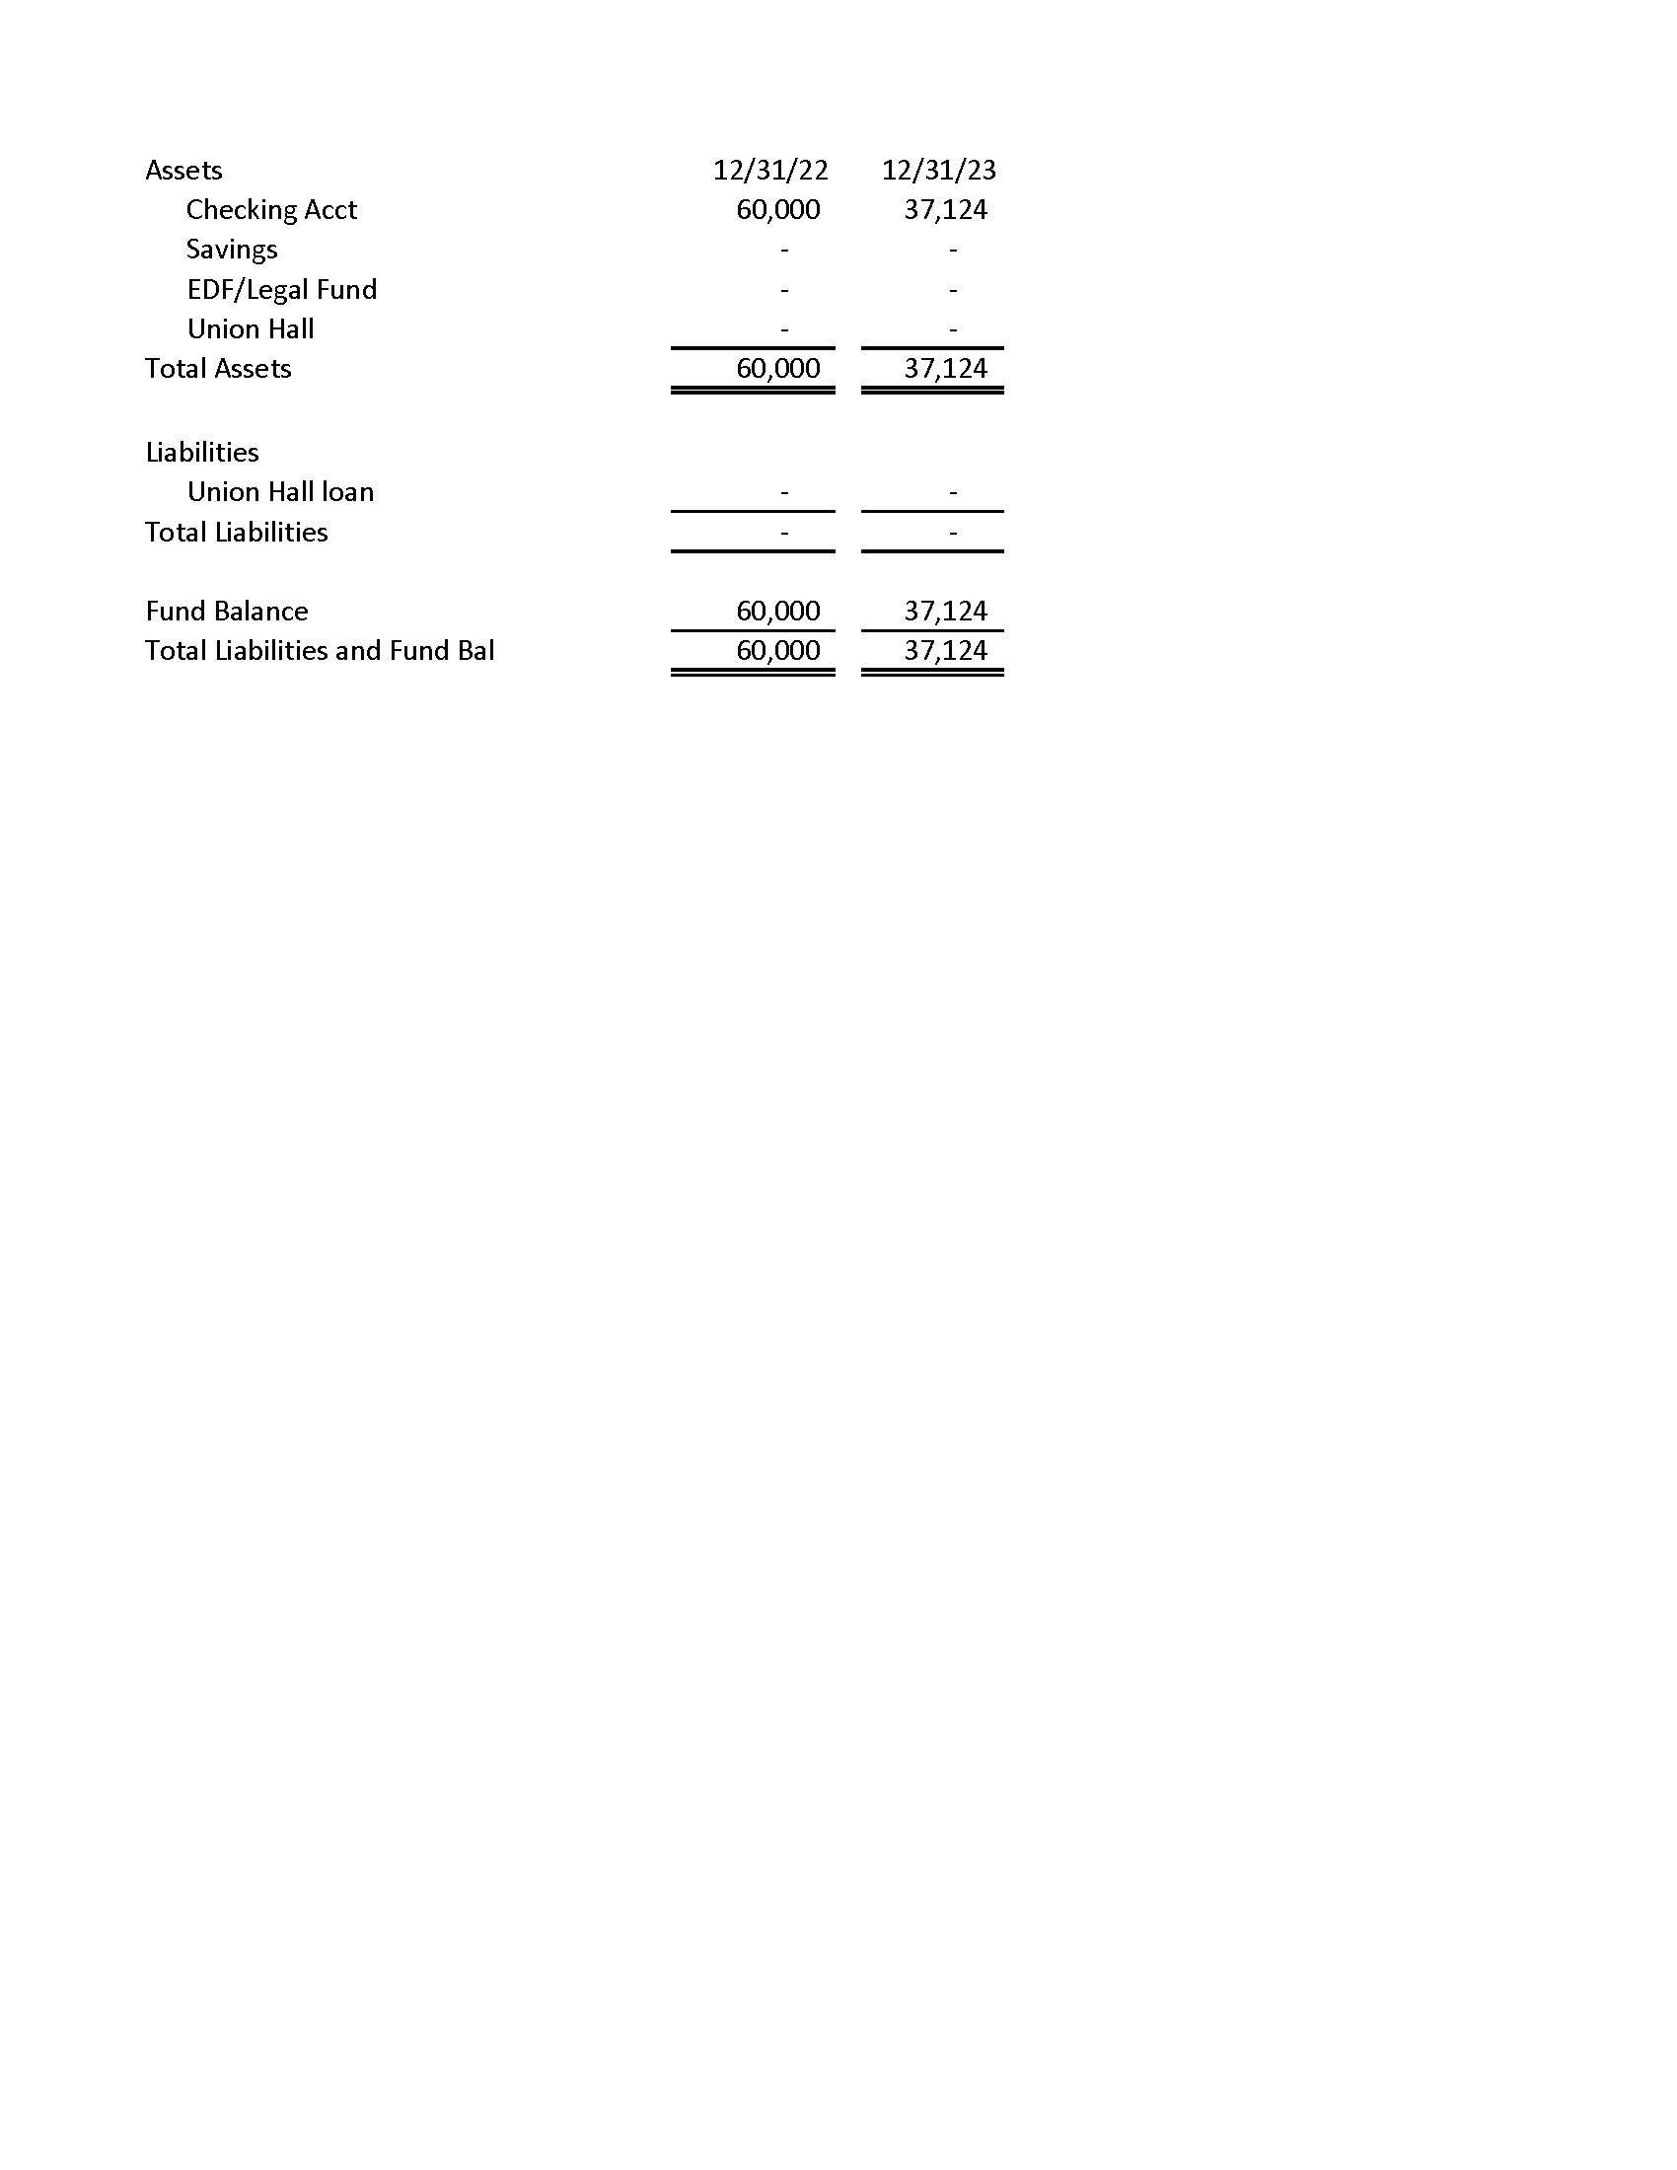
Financial Statement
Notes:
Ending bank balance should be $57,124 (60,000-2,876). $20,000 is missing

Slide 47
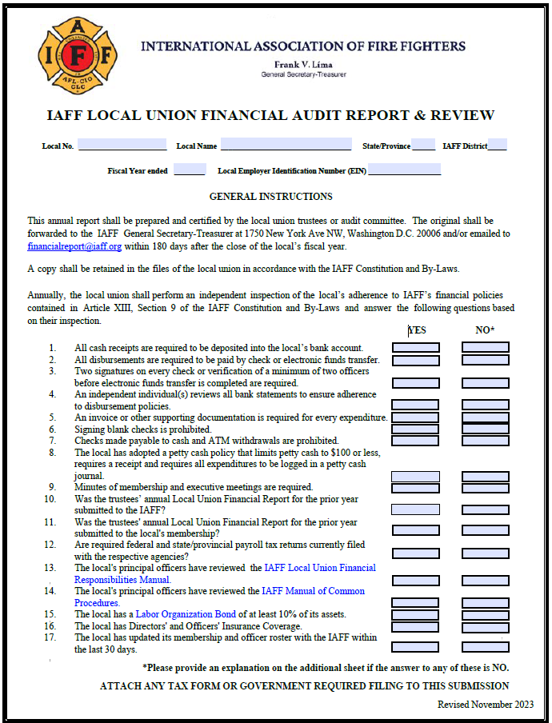
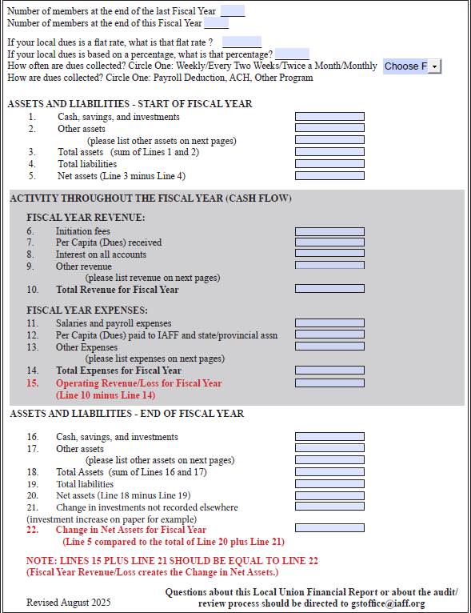
IAFF Local Union Financial Audit Report

Slide 48
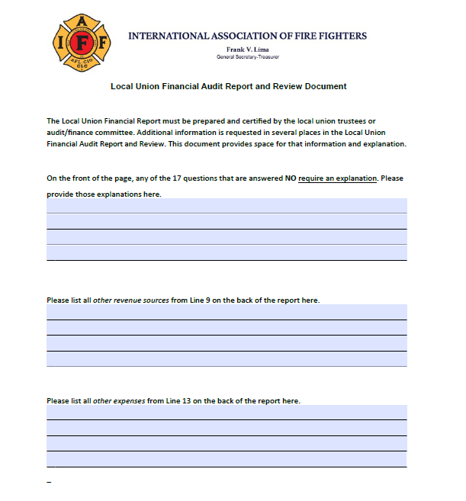
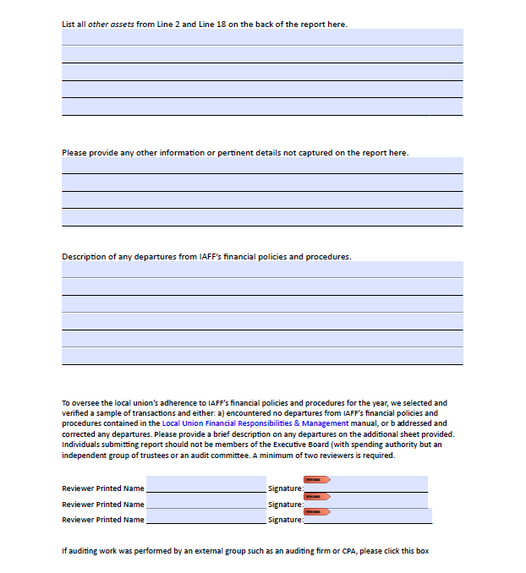
IAFF Local Union Financial Audit Report

Slide 49
Local Union Financial Report
Common Errors & Concerns
Wrong EIN – some are using the department’s number.
    This can create a reporting issue.
Checking the Director’s and Officer’s Insurance Box.
Not punitive, just gauging how many have it.
Local board members signing the form.
Not including an attached sheet with expense/revenue breakdown.
Too little information to detect trends or issues
Revenue minus expenses not matching with change in net assets.

Slide 50
Investments

Slide 51

Investment Considerations
How liquid do you want your investment to be?
  Certificates of Deposit
  Real Estate
  Cash
  Other

Slide 52
Certificates of Deposit
Generally considered a safe, stable investment.
Low risk, low reward.
PROS
  Safety
  Guaranteed Returns
  Higher Rates than Checking Account
CONS
  Accessibility
  Lower Returns than Market
  Inflation Risk

Slide 53
Real Estate
Long-term investment.
Unless investing as an owner-occupied office or union hall, it is likely not a good option for local affiliates.
PROS
  Good ROI
  Appreciation
CONS
  Low Liquidity
  High investment cost

Slide 54
Generational Inequity
Use caution in regard to large investments on assets that are paid for by one generation of union members but the next generation own the asset without making the investment.
This is a concern when discussing union halls and other large financial projects.

Slide 55
Cash
For most locals, a cash investment will be a large part of their portfolio. This is perfectly acceptable and a viable strategy for planned spending.
This includes savings, checkings and money market accounts.
PROS
  Funds available for emergencies
  Less Risk
CONS
  No or minimal ROI

Slide 56
Lines of Credit
Using credit can be a viable option when lending interest rates are lower than rates of return on other investments.
Credit also allows for liquidity when investing in other nonliquid platforms such as real estate.

Slide 57
Subs vs
Employees

Slide 58
Sub-Contractor vs Employee
Who has control over what the worker does and how the worker does his or her job?
How is the worker paid, are expenses reimbursed, who provides tools/supplies?
Does the worker have similar clients?
Are there written contracts or employee type benefits?
See IRS 20 question test

Slide 59

Sub-Contractor vs Employee
Union Officers
Work replacement
Other scenarios?

Slide 60
Payroll
Employer Costs
FICA 6.2% of wages up to $162,200 then 0 (2023)
Medicare 1.45% of all wages
Federal Unemployment 6% of first $7,000 but there is a 5.4% credit if State Unemployment is paid
State Unemployment determined by State
Workers Compensation Insurance (varies by state)

Slide 61
Payroll
Federal withholding, FICA and Medicare payroll deposits due by the 15th of the month following payroll if over $2,500 per quarter. Must use EFTPS if paying monthly
FUTA due quarterly or annually based on amount, over $500 must use EFTPS
State payments vary based on amount and type

Slide 62

Payroll from 1099
Notes:
15% of 2,000 is 300

Slide 63
Payroll Reporting Dates
W-2 due to employee by January 31
W-3 due by January 31
941 due end of month after each quarter
4/30, 7/31, 10/31, 1/31
940 due by January 31

Slide 64
1099s
1099 anyone paid $2000 or more in a year, that is not a corporation, due by January 31
Local should have them fill out a W-9 before they are paid
Form 1099-NEC (Non employee compensation)
1096 summary of all 1099’s due by January 31

Slide 65
Bonding Amounts

Slide 66
Bonding
IAFF covers first $5,000
Best Practice is a Bond of 10% of FUNDS HANDLED
  Liquid Assets and Total Receipts
Private and Federal Locals MUST have a 10% Bond
Can purchase through same company IAFF uses
If funds go missing, you can be reimbursed up to your bonding amount

Slide 67
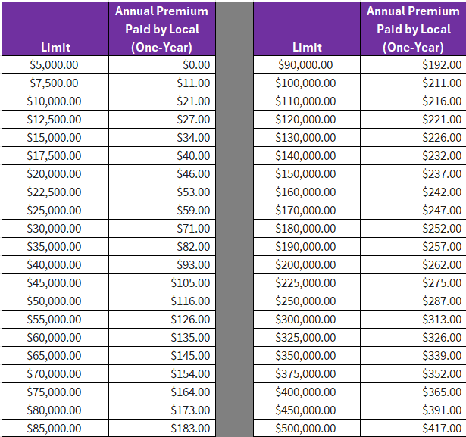
Bonding Rates
One-year Premium
$10,000 for $21
$50,000 for $116

Slide 68
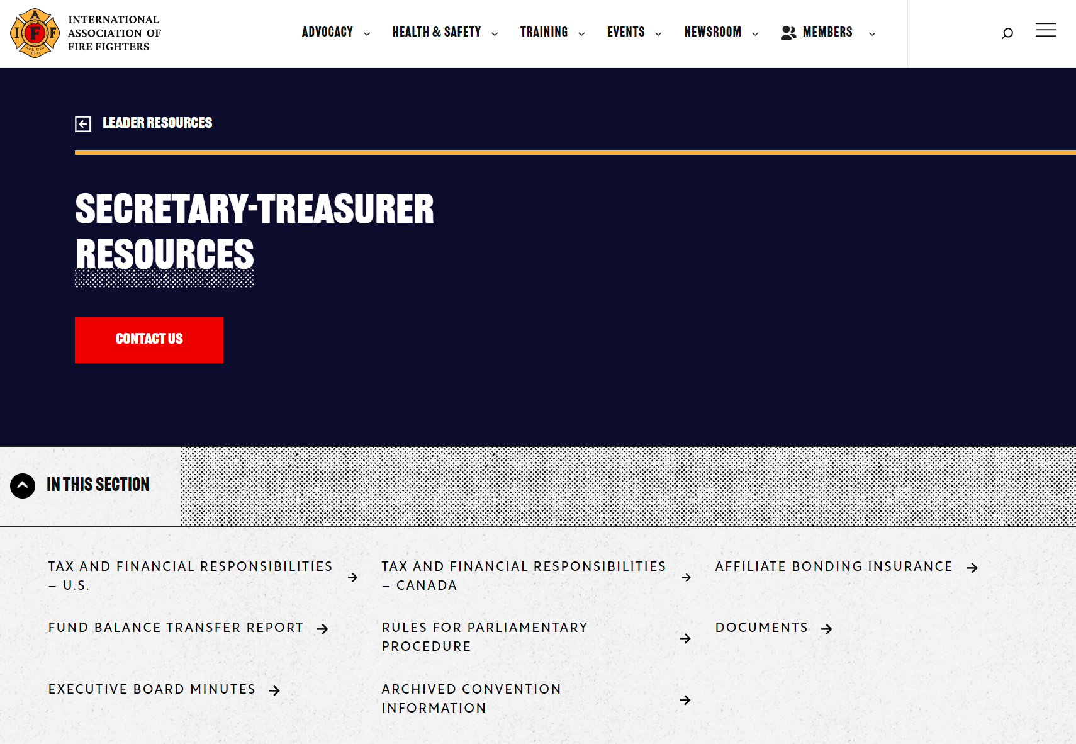

Secretary-Treasurer Resources
www.iaff.org/secretary-treasurer-resources/

Slide 69
THANK YOU!
ANY QUESTIONS?
gstoffice@iaff.org
Notes:
Keeping the photo? Right-click on the image, select “Change Picture,” find your file, and place the image. If you need to reposition the face to be centered, use the “crop” tool in the “Photo Format” menu. Contact Communications Division or Education Department for assistance.

