Slide 1

Politics: The Rules You Should Know WSCFF Ed Seminar April 21, 2026 Abby Lawlor (206) 644-6002 lawlor@workerlaw.com

Slide 2
What We’ll Cover
Campaign Finance Basics
Contributing to State and Local Campaigns
Making Independent Expenditures
Handling PDC Complaints

Slide 3
Why care about the rules?
What AJ and Nich said!
By being politically involved, the Union can:
Elect candidates who support workers and hold them accountable
Pass levies, bonds, and other ballot measures that impact your work
Support legislation/regulations to improve workplace safety, healthcare and retirement, etc.
By knowing the rules, the Union can:
Avoid paying additional taxes
Stay clear of potential Public Disclosure Commission investigations and fines
Uphold public interest in political transparency

Slide 4
Campaign Finance Basics
Unions CAN spend money to influence the outcome of state and local elections in Washington.
BUT there are two things to worry about:
Spending money in politics could impact the Union’s taxes.
The Union must comply with WA campaign finance law (Fair Campaign Practices Act, RCW chapter 29B).

Slide 5

Starting with the fun stuff first – TAXES

Slide 6
Union’s political activity is not tax-exempt
If the Union is doing political spending from its general fund, Union will be taxed on the lesser of:
Net investment income (also includes dividends, rents, capital gains) OR
The total amount that the Union spends to support or oppose candidates.
Tax is at the highest corporate tax rate.
TIP: Union can avoid this tax by setting up a Separate Segregated Fund (SSF).

Slide 7
What is an SSF?
Essentially, a separate bank account that the IRS treats as a separate taxpayer
SSF is a section 527 entity, while the Union is a 501(c)(5) entity
SSF is not taxed on political spending on candidates
Funds in the SSF can ONLY be used for candidate support (or opposition), NOT levies, bonds, or other ballot measures.

Slide 8
To SSF or not to SSF . . .
An SSF likely makes sense if:
The Union has significant investment income AND
You plan to spend a fair amount on candidate campaigns.
You probably don’t need an SSF if:
You don’t have investment income OR
You only plan to spend money on levy/bond/initiative campaigns.

Slide 9
How to set up an SSF
Obtain an EIN and establish a separate bank account
SSF accounting should be separate from Union’s general fund
File form 8871 with the IRS
Must file annual tax return for the SSF
Must also file periodic reports of contributions and expenditures if spending $25k or more (unless reporting as a PAC to the PDC)
Follow certain rules in moving general fund money into SSF:
Must be “new” money that has not generated interest for the Union
If your SSF is not a PAC, move a fixed amount that is less than regular income and not based on member #s

Slide 10
Enough about taxes…(for now).

Slide 11
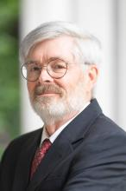

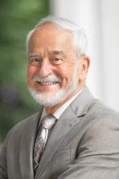
Fair Campaign Practices Act, RCW 29B
Enforced by the WA Public Disclosure Commission (PDC) with support from the Attorney General’s Office
In addition to campaign finance, also addresses state-level lobbying
?
?

Slide 12
Key CF Requirements of RCW 29B
Registration: If your Union or SSF acts like a PAC, you may need to register as a political committee (PAC) with the PDC. (Alternatively, you may need to register as an incidental committee).
Ongoing Reporting: required if you are a PAC or incidental committee, or make certain independent expenditures.
Disclaimers: required for most political advertising.

Slide 13
You probably don’t need to engage with the PDC if…
…you communicate with Union members about candidates and issues, but not the general public.
…you facilitate volunteering by members and staff for campaigns.
…you make occasional cash contributions to candidates or ballot measure campaigns.
TIP: PDC staff are available to answer compliance questions. When in doubt, ask!

Slide 14
You will probably need to engage with the PDC if…
…you communicate with the general public in support or opposition to a candidate or ballot measure.
…you spend a significant amount of money on contributions or make independent expenditures.
…you raise money from members (or other people) to spend specifically supporting or opposing candidates or ballot measures.
…you have an SSF that accepts outside money or member-based contributions.

Slide 15
What is a Political Committee? (PAC)
Two ways to become a PAC:
“Contribution prong” – soliciting/accepting any money specifically to spend in support or opposition to candidates or ballot measures
“Expenditure prong” –supporting or opposing candidates/ballot measures is a “primary purpose” of the organization
PDC looks at several factors
Generally won’t be met if organization spends less than 30% of its general fund/resources on politics
PACs must register and report ALL contributions (money in) and expenditures (money out).

Slide 16
Incidental Committees
Nonprofit organization (e.g., Union) may become an incidental committee if:
It spends $35,000 or more in a calendar year on campaigns; AND
It receives $15,000 or more from any single source
This can be for ANY reason (ex: building lease, grant from IU)
Incidental committees must register with the PDC and report:
Top ten contributors of $15,000 or more
Political expenditures if they exceed $500 in a given month

Slide 17

Back to SSFs…

Slide 18
How does this all fit together?
SCENARIO 1: Union does not have an SSF and does all political spending from its general fund. | Union may be required to register as a PAC or an incidental committee.
SCENARIO 2: Union has an SSF and does all political spending (candidate-only) from its SSF. | SSF may be required to register as a PAC.
SCENARIO 3: Union has an SSF. It does levy/ballot measure spending from its general fund and candidate spending from its SSF. | Union may be required to register as a PAC or an incidental committee. SSF may separately be required to register as a PAC.

Slide 19

Contributing to state and local campaigns

Slide 20
What is a contribution?
“Loan, gift, deposit, subscription, forgiveness of indebtedness, donation, advance, pledge, payment, transfer of funds, or anything of value, including personal and professional services for less than full consideration”
Cash contributions
In-kind contributions: includes paid staff time and resources spent on behalf of a campaign.
Dissemination of campaign materials
“Coordinated” expenditures

Slide 21
What ISN’T a contribution?
Internal member communications
Includes members and people in their households
CAN be coordinated with a candidate/campaign; BUT:
CAN’T just be a reproduction of the candidate’s own materials
Volunteer services
Not on paid time
Union can’t guarantee a certain number of volunteers to campaign
Independent expenditures – more to come on this!

Slide 22
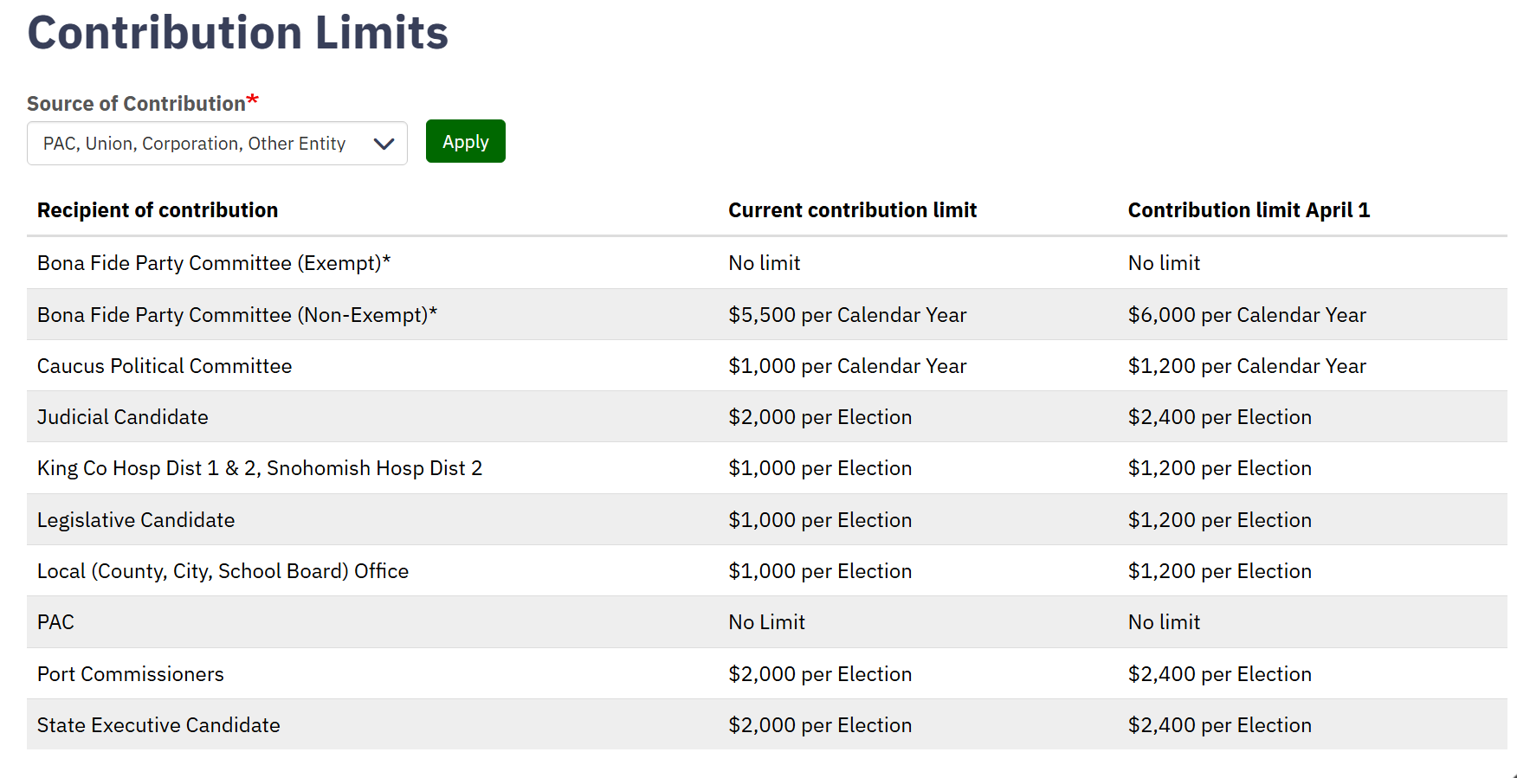

Slide 23
What to Avoid:
Exceeding contribution limits
Separate limit will apply for general and primary
NOTE: Once a state council or IU endorses or contributes money in a race, contributions will be aggregated across all affiliated locals.
If WSCFF endorses or contributes, all WSCFF affiliate locals will have a shared contribution limit.
Local contributions made before WSCFF participates in the election DON’T count.
Prohibited use of public facilities
RCW 29B.45.010 prohibits public employees from using “any of the facilities of a public officer or agency” to assist a campaign.
Includes work time, phones, internal mail systems, printer, etc. Also, the fire truck, uniforms.

Slide 24

What if you want to do more?

Slide 25
Independent Expenditures (IEs)
Union can spend an unlimited amount, IF expenditures are not coordinated with a candidate campaign.
Typically political advertising, but could include other things.
Must be reported to the PDC if spending $1,000 or more.
TIP: If Union is in communication with a candidate/campaign, implement a clear firewall to prevent coordination.

Slide 26
What is political advertising?
Lots of things!
TV, radio, newspaper ads
Billboards, lawn signs
Flyers, mailers
Emails or text messages (if sending 100+ identical messages)
Paid social media, Youtube ads, etc.
Political advertising typically must include a Sponsor ID
Paid for By Union Local No. 1234, 500 Main Street, Seattle, WA 98119.
If a PAC, Sponsor ID must also include Top 5 / Top 3.
If an IE: “No candidate authorized this ad. Paid for by. . .”

Slide 27

What to do if you get a PDC complaint

Slide 28
PDC Complaint Process
Any person can file a complaint with the PDC.
PDC is required to make a preliminary inquiry.
You will be given a copy of the complaint and a 2-week window to respond.
This deadline is flexible! You can always ask for an extension.
PDC will evaluate complaint and your response and may request additional information.
Complaint may be resolved or escalate to a full investigation.

Slide 29
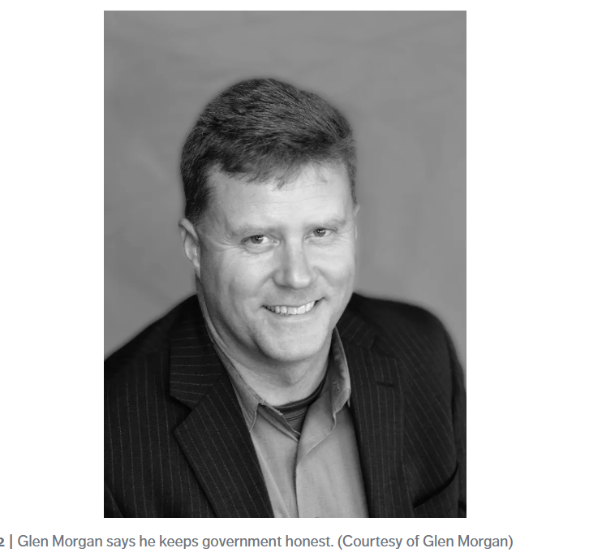
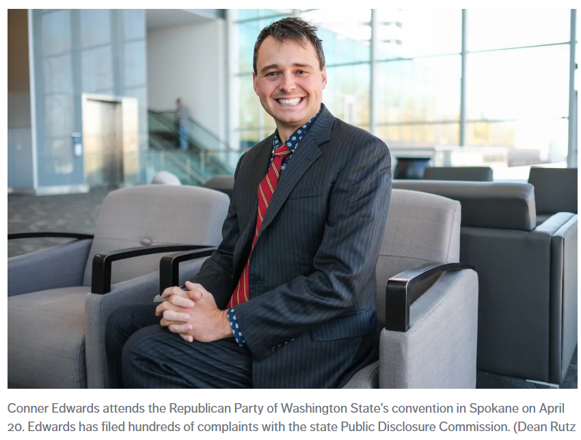
The likely filers…

Slide 30
How to respond:
Call a campaign finance attorney!
Carefully review the complaint
Don’t assume the allegations in the complaint are correct
Also review any reports mentioned in the complaint
Ask for an extension to the response deadline if needed
Draft a written response
Focus on explaining the facts.
NOTE: Your written response will be published online along with the complaint, even if it’s just an email back to the PDC.

Slide 31
Questions?

