Slide 1
Before the “Leave”
Creating and Maintaining Scene Safety
By: Chris Barney

Slide 2

Never find yourself
in a fair fight

Slide 3
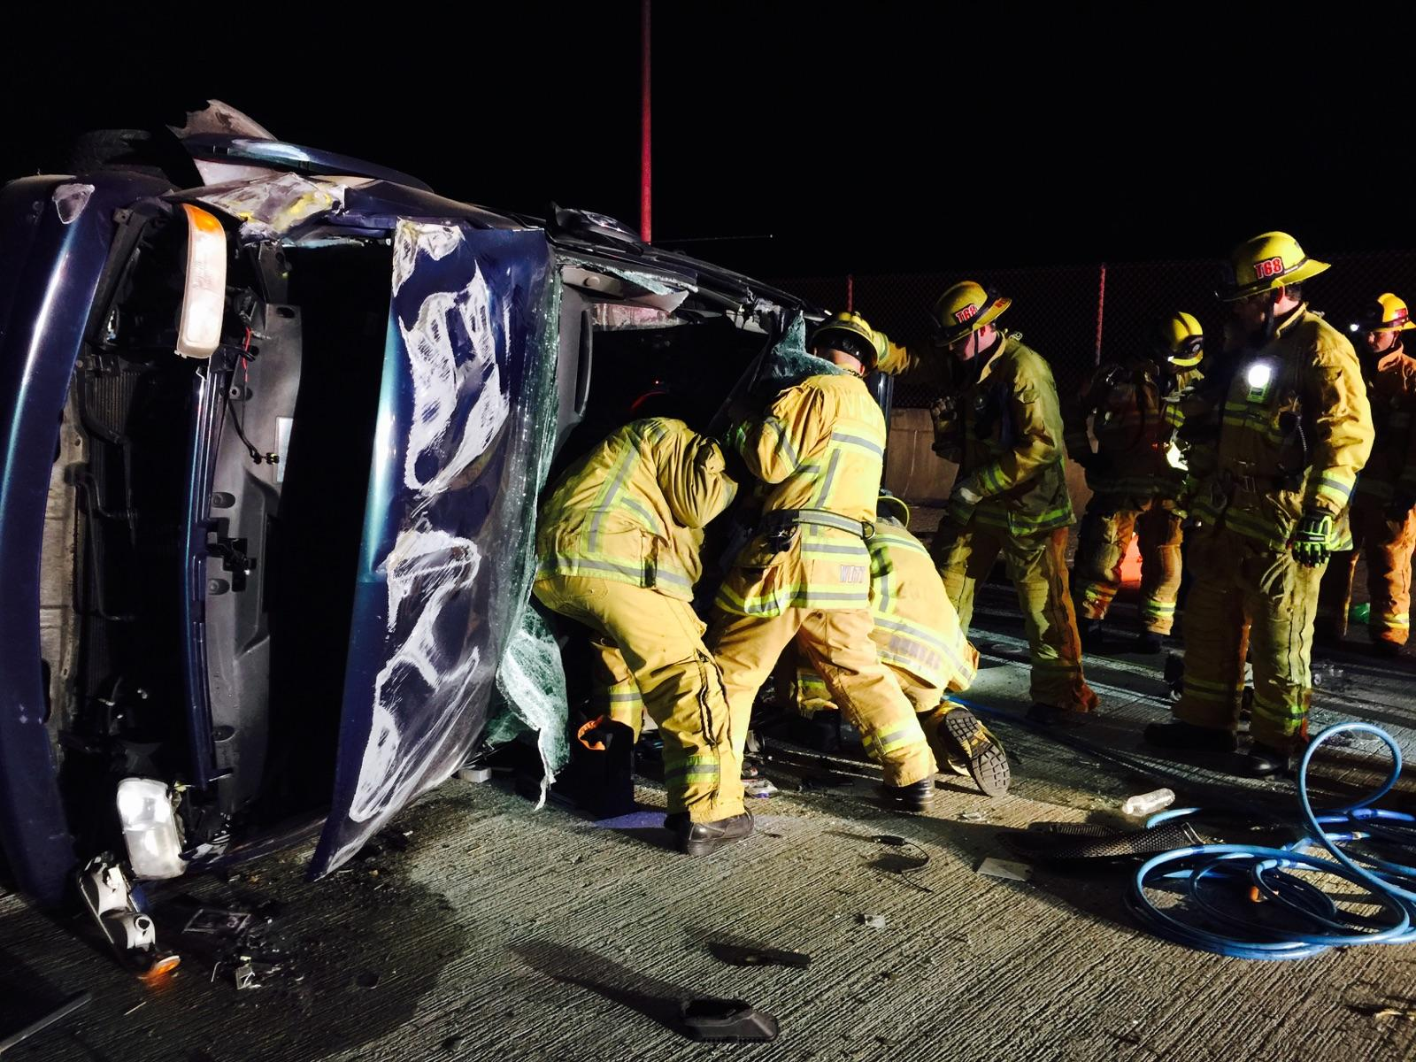
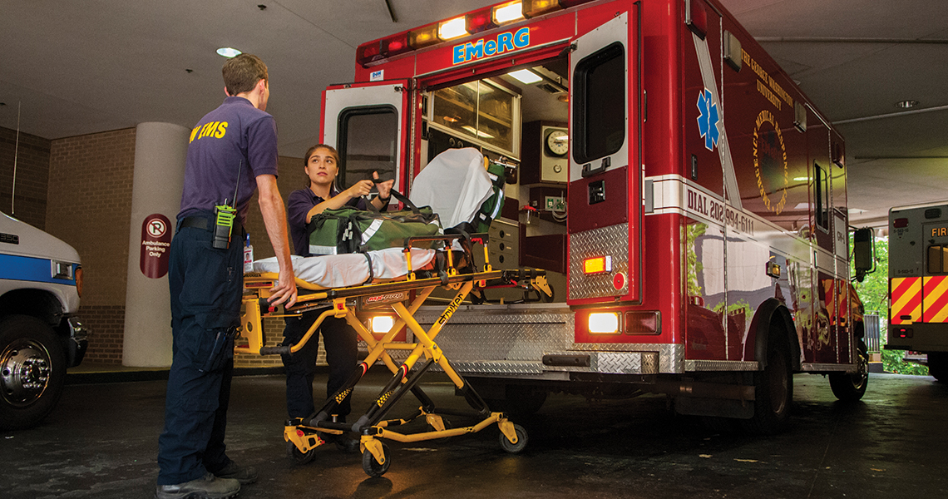
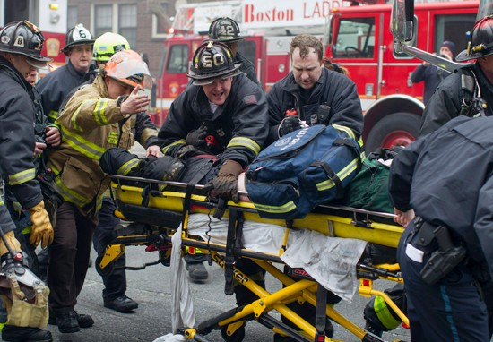
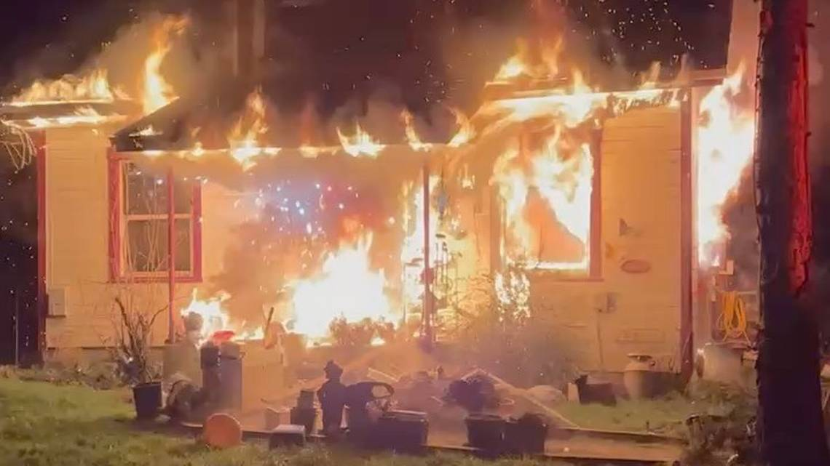
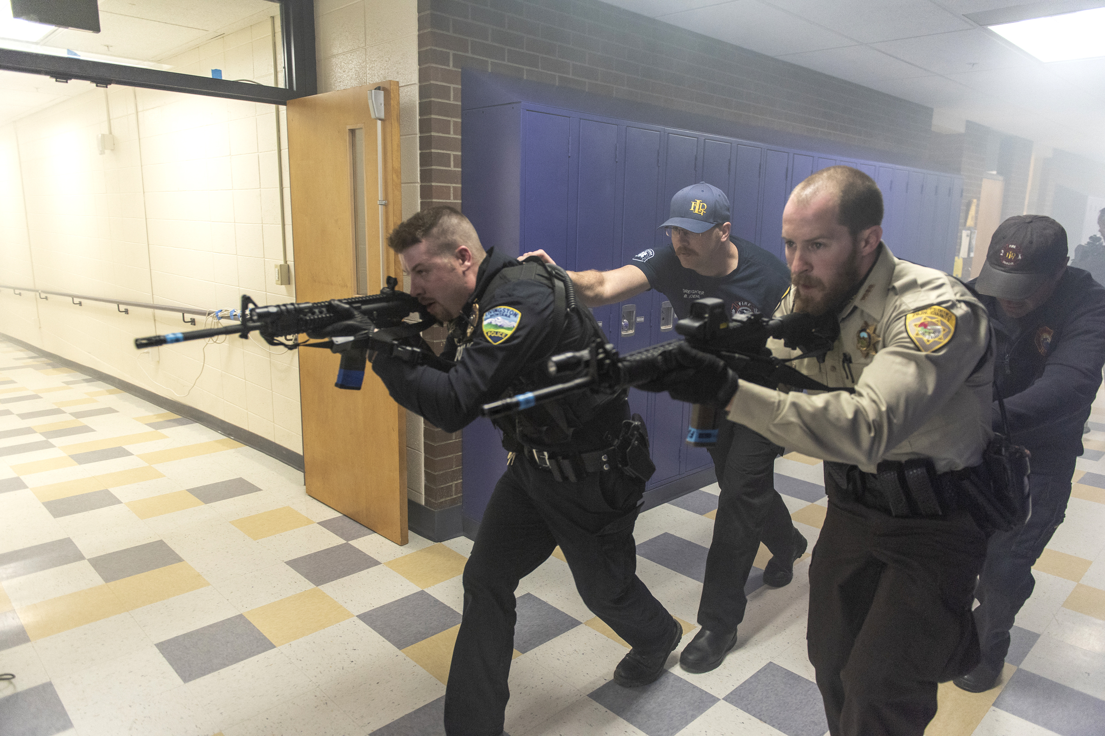
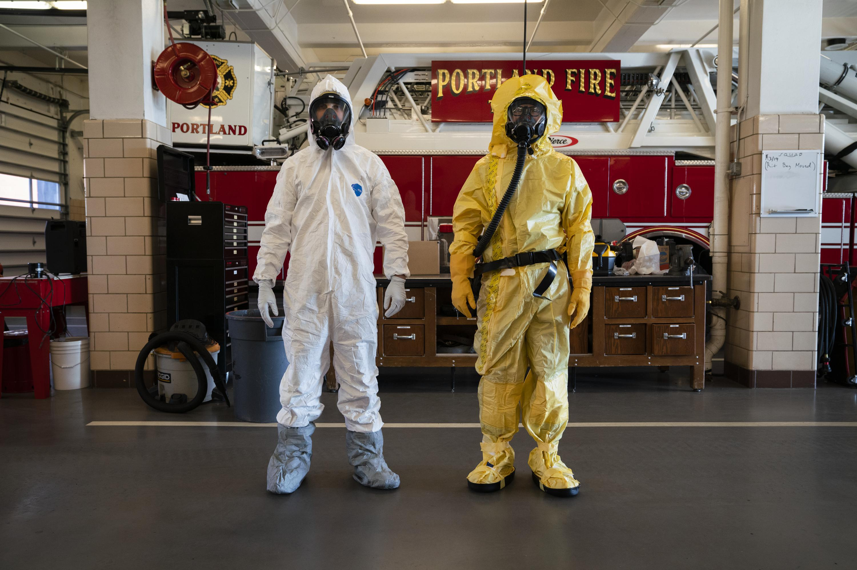
Our operational environment

Slide 4
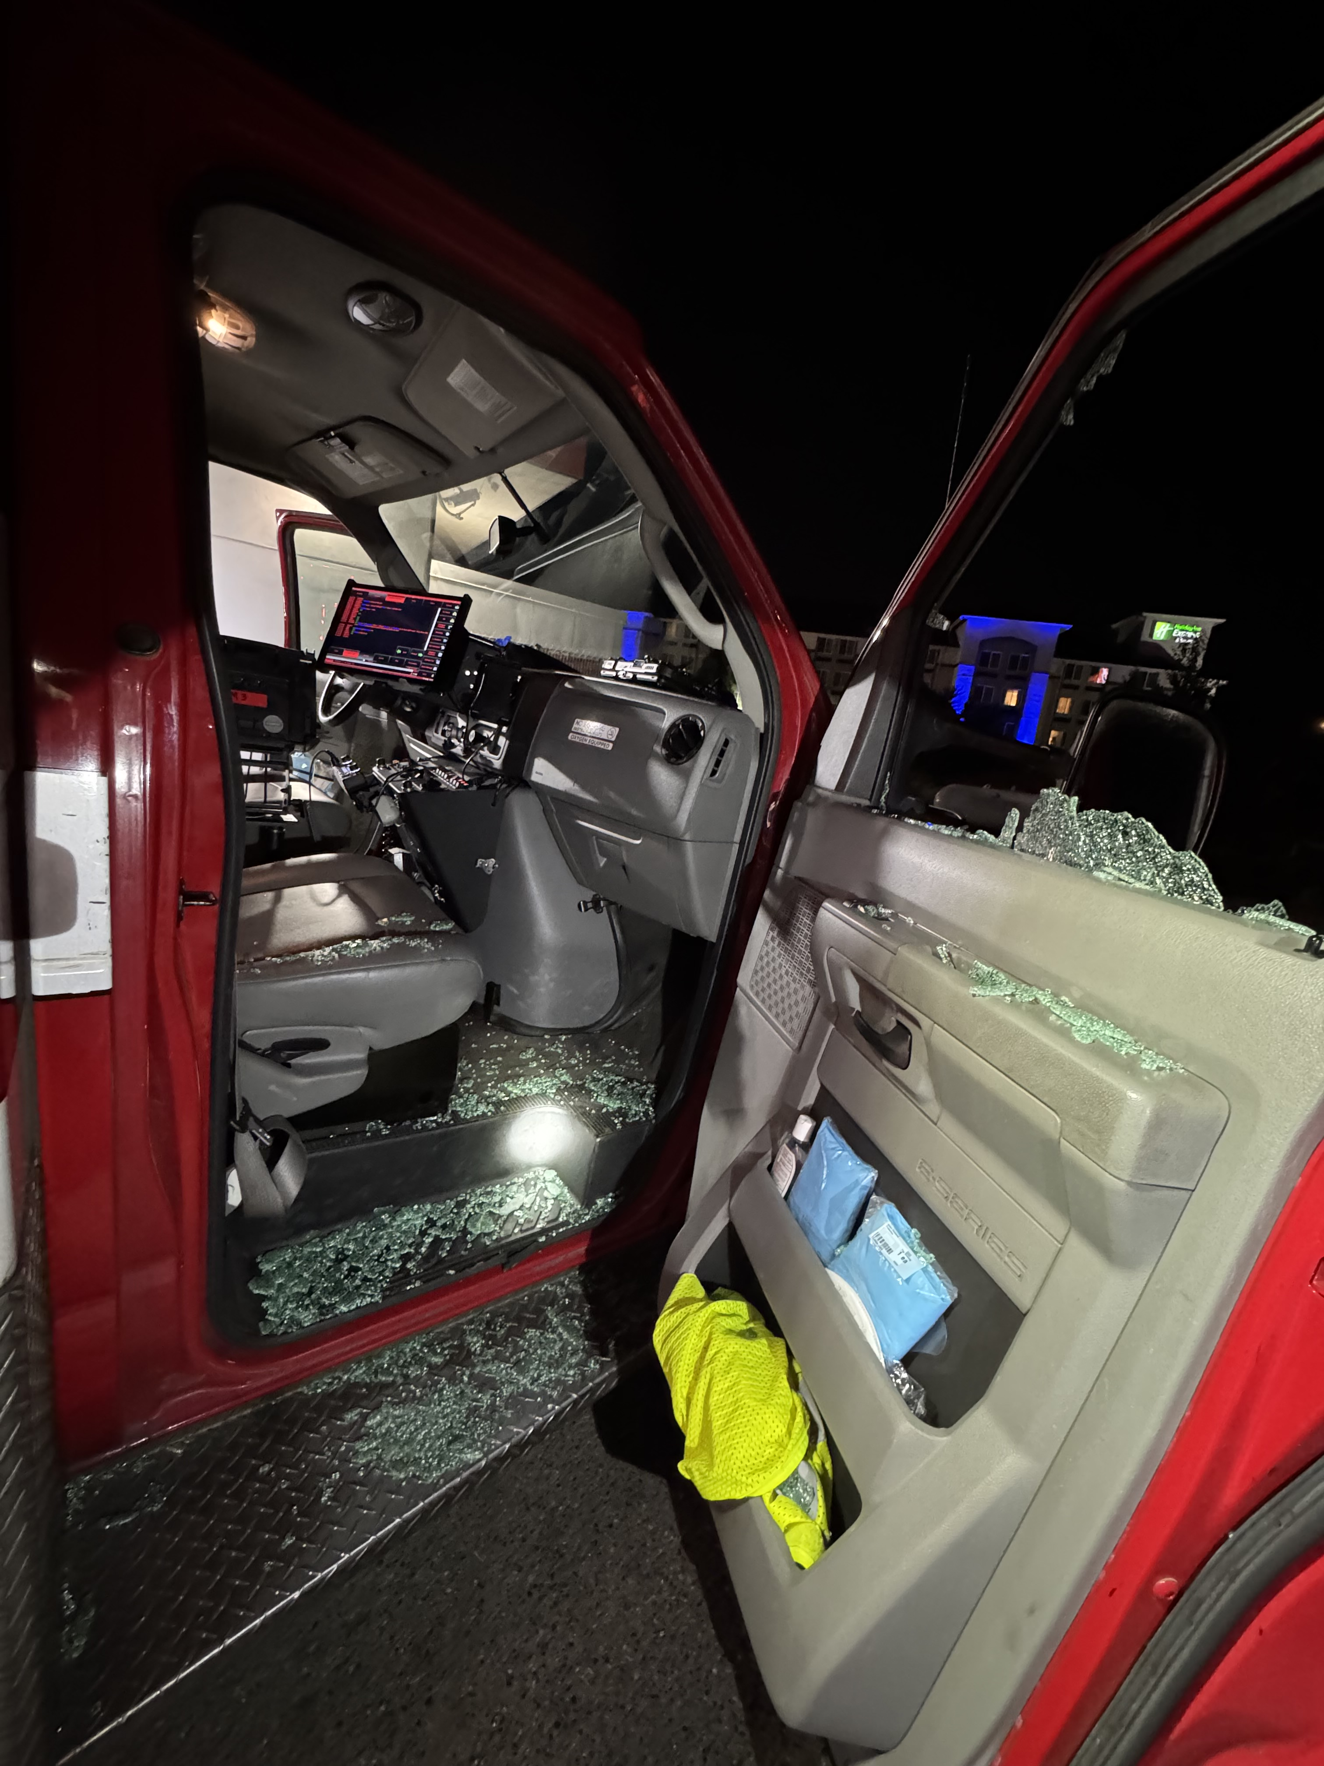

Slide 5
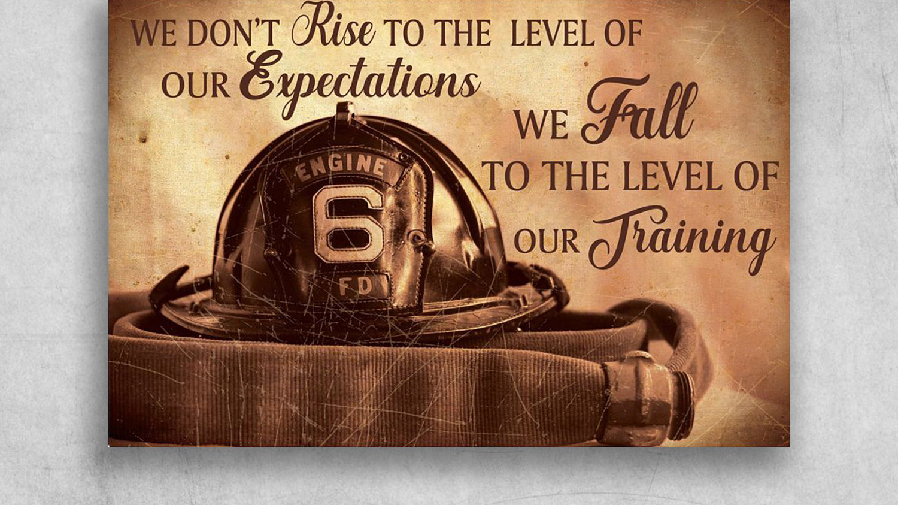


Slide 6
What is Situational Awareness
Situational Awareness (SA) refers to the perception and understanding of the elements in one's environment and the comprehension of their meaning. In simpler terms, it's being aware of what's happening around you, understanding the context, and anticipating future developments.

Slide 7
Our Goal
Our goal is to increase our Situational Awareness, identify potential threats, and place ourselves in the best position possible to leave a bad situation before it happens.

Slide 8


Slide 9
DATA
According to EMS1 there are over 2,000 reported EMS worker assaults a year
Drexel University and the FIRST center found 350 reported assaults on Firefighters in 2021. A year later in 2022, researchers found 593
NY Post reported 137% increase in first responder assaults.
An international survey on violence against EMS personnel says EMS in the U.S. have a violence‐injury rate about 22 times higher than the national average of all workers.
Data is hard to find. Why is that?
Do you know the departments reporting system?

Slide 10
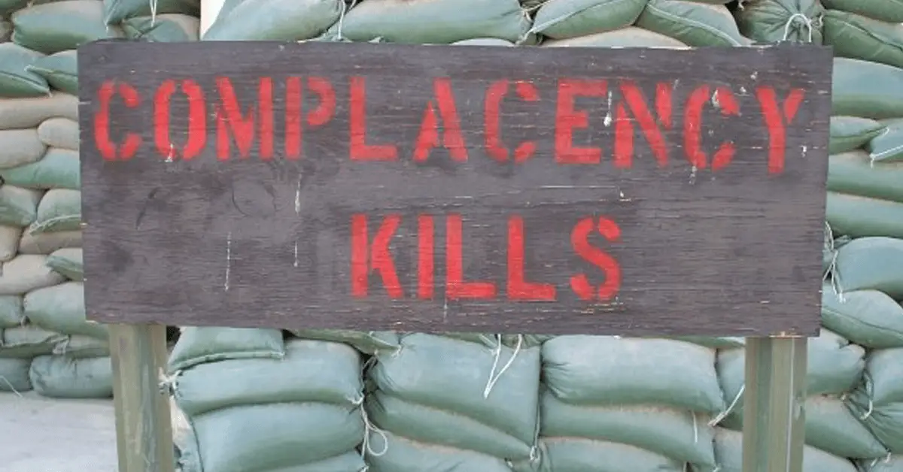

Slide 11
Outline
Mindset
Approach
Threat Assessment
Pt Assessment

Slide 12
Mindset
Situational Awareness is a critical mindset and skillset that involves being aware of your surroundings, understanding what is happening in your environment, and anticipating potential developments. It is essential in various contexts including personal safety, emergency response, and everyday life.

Slide 13
Mindset
Observation: The first step in developing situational awareness is to actively observe your environment. Pay attention to details, both big and small. This includes being aware of people, objects, sounds, and changes in the environment.
Comprehension: After observing your surroundings, try to comprehend what is happening. This involves processing the information you've gathered and understanding its significance.
Anticipation: Part of situational awareness is being able to anticipate what might happen next. This requires you to consider various scenarios and think ahead.

Slide 14
Mindset
Risk Assessment: Assess the risks and potential threats in your environment. This involves evaluating the likelihood and severity of various outcomes.
Decision-Making: Once you've observed, comprehended, anticipated, and assessed the situation, you need to make decisions based on the information. These decisions should be proactive and aimed at improving or maintaining safety, security, or achieving your objectives.

Slide 15
Mindset
Flexibility: Situational awareness isn't a one-time thing. It's an ongoing process that requires adaptability. Be prepared to adjust your actions and decisions as the situation changes.
Information Gathering: Continuously seek new information and updates to maintain your situational awareness.
Communication: In many situations, effective communication is key to maintaining situational awareness. Sharing information and insights with others can lead to better decision-making and response coordination.

Slide 16
Mindset
Training and Practice: Developing situational awareness is a skill that can be improved with training and practice. This might involve scenario-based training, simulations, or practicing being mindful in everyday situations.
Mindfulness: A mindful and focused mindset is essential for situational awareness. Avoid distractions and remain present in the moment to better understand and respond to your environment.

Slide 17
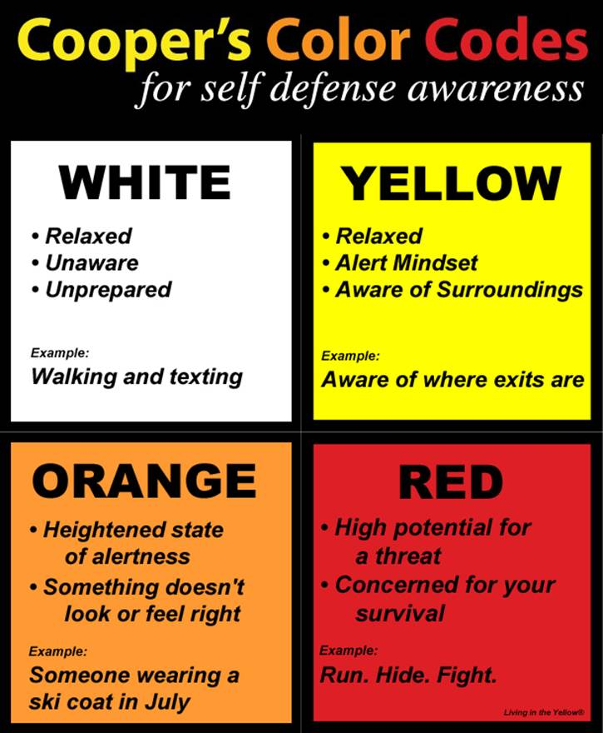

Slide 18
Approach
Information Gathering
  MCT
  Proper address
Team integrity
  Approach as a unit
  Designation
  Roles and Responsibilities
  Building Entry
    Access/Egress
    Identify primary and secondary entry and exit points

Slide 19
Approach
Control and Manage lights and distractions
  Turn on lights and turn off TV’s and other distractions
Scanning the Room
  Entry/Exit points
  Potential Weapons
  Drugs
  People and Animals

Slide 20
Vehicle Approach
Approaching Vehicles
  Position Apparatus behind
  Tactical Approach
    Point and cover
  Use B Pillar
  Visually inspect the inside of the car for people and or potential threats

Slide 21
Threat Assessment
Potential Weapons
  Remove Potential Weapons or Remove Pt from Danger Areas
  Look at hands
Behavioral Threats
  Body Language (posturing)
Behaviors
  Does the Pt’s behavior match the situation
  Bump in the system (outliers)

Slide 22
Patient Assessment
Angles of approach
  Use angles to get a better assessment of rooms or vehicles
Immediate scene evaluation
  Threat assessment
  Looking for potential weapons
  Broader sweep of the house for potential threats
Crew placement and positioning
  Try to never have the patient between you and an exit
  Crew should be placed to maximize safety and minimize potential blind spots

Slide 23
Patient Assessment
Place patient in a position of disadvantage
  Sitting down
  Legs crossed
Body positioning to minimize any potential attack from unpredictable or potentially aggressive patients.
  Unconscious vs Conscious
Keep patient’s hands in sight
  The most common attack will be a punch or grab
Deescalate
  It is not personal
  Talk calmly
  Use empathy

Slide 24
In closing
Situational awareness is a mindset
Set ourselves up to be in positions of advantage
Our goal is to recognize and avoid potentially threats
Always have an exit plan

