Slide 1

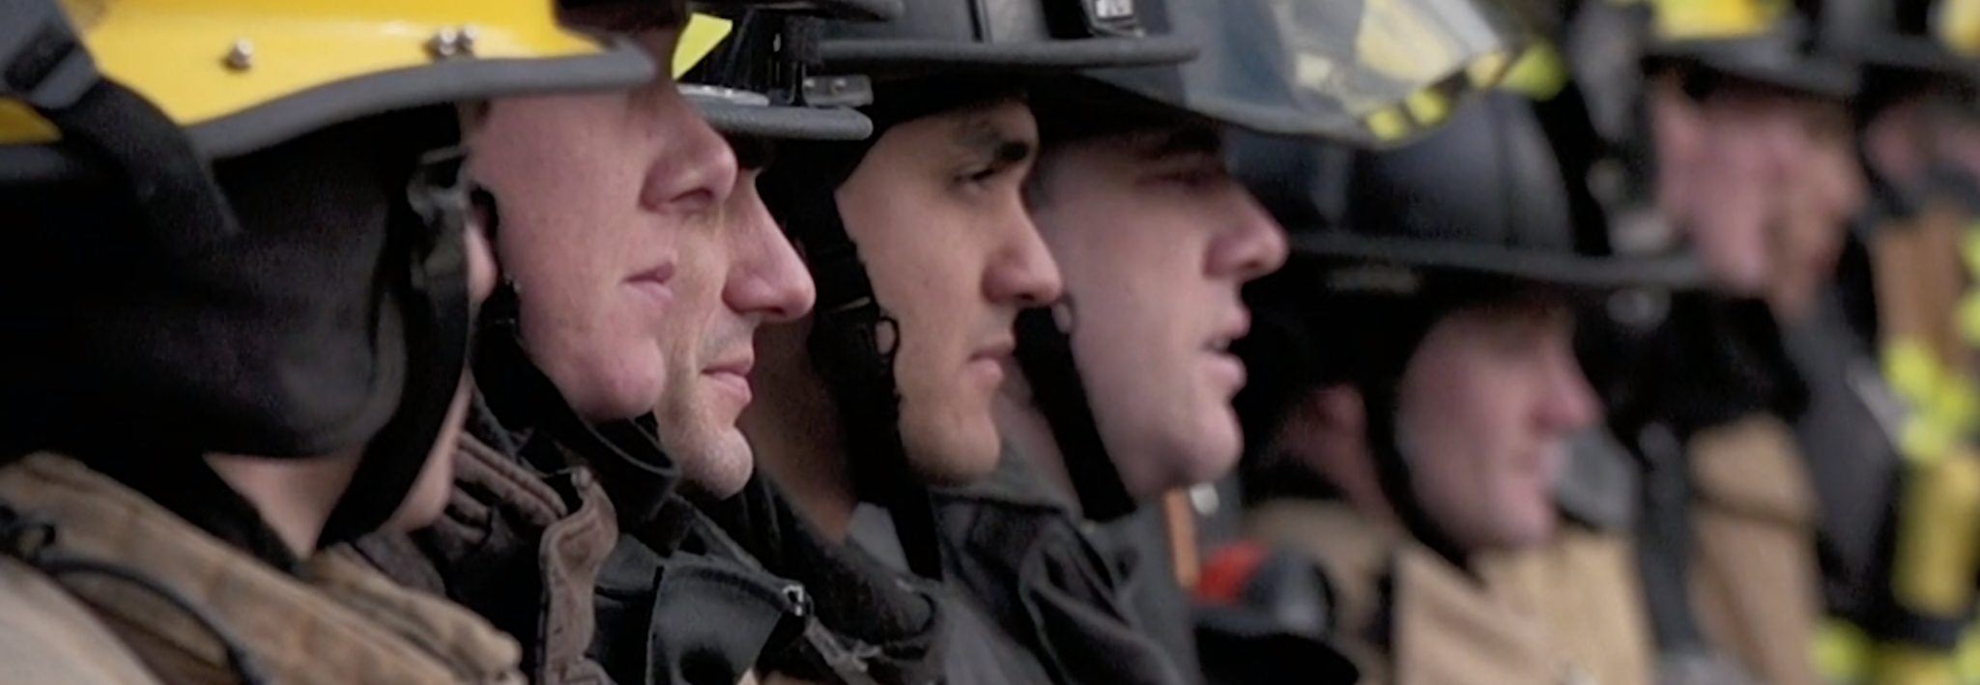

Washington State Fire Service LODD- Guidelines and Procedures
Dennis Lawson, WSCFF President
April 21, 2026

Slide 2
Agenda
Review Resolution 25-14
The Line of Duty Death Packet
Review – The Functions, Process, and Benefits
Picture/ pictures can go here – length of the top of presentation to the bottom golden line

Slide 3
Resolution 25-14
RESOLVED: That the Washington State Council of Fire Fighters President or their designee explore and report back at the 2026 IAFF-WSCFF Educational Seminar a Line-of-Duty Death Resources Packet and be it further;
RESOLVED: That the Line-of-Duty Resources Packet provide guidance in benefits, functions and processes associated with Line-of-Duty Deaths, including but not limited to, state and federal benefits, third-party insurer claims, pension entitlements and fallen fire fighter ceremonies; and be it further
RESOLVED: That the Line-of-Duty Death Resources Packet serve as a guide for the families and locals affected by Line-of-Duty Deaths to ensure timely and accurate delivery of benefits, compliance with legal requirements, and compassionate support, from the initial loss through the completion of all related processes.

Slide 4
How to Access
WSCFF Website
Home - Washington State Council of Fire Fighters
WA-State-Firefighter-Death-Policy-2024.pdf
Google – Washington State Fire Service LODD Guidelines and Procedures
Washington state fire service LODD guidelines - Search

Slide 5
Stakeholder Group
State Chiefs
Commissioners
Volunteers
State Council
DNR

Slide 6
Line of Duty Death Packet
Objectives
Provide a uniform procedure
To assist the agency, local, and more importantly the family
Provide clear instructions for those taking on key roles
To ensure a unified commitment to the agency, local, and family

Slide 7
Key Piece
A career or volunteer fire fighter whose death is determined a line of duty death per state or federal and IAFF guidelines will be afforded full honors as outlined in this document.
The family wishes and/or direction will always set the path.

Slide 8
Levels of Honor
Level 1 – Line of Duty Death
Level 2 – Non-Line of Duty Death
Level 3 – Non-Line of Duty Death in active retired member or affiliate member

Slide 9
Death Benefits and Survivors Guide
To assist the surviving family, department, and local. This section outlines the benefits and resources available to the surviving family.

Slide 10
Honors
LODD
Name on IAFF Memorial
Name on National Fallen Fire Fighter Memorial Wall
Survivors Program (if awarded PSOB or presumptive cancer)
Name on the Washington State Fallen Fire Fighters Memorial

Slide 11
Benefits
The benefits listed is the guide are not all inclusive. There may be additional benefits that are associated with your cba, personal insurance, and associated organizations.
Make sure that there is ONE point of contact to act as a benefit coordinator.

Slide 12
Contact LEOFF 2 Ombuds Program
Tammy Sadler and Jessica Burkhart
This should be one of the first calls made by the benefits coordinator
Great resource – Experienced and Professional

Slide 13
Federal Benefits
Administered by the U.S. Department of Justice
Recently expanded through HR 237- which was part of the National Defense Authorization Act
Provides -
Death and Disability Benefits- $461,656
Educational Benefit $1488, per month / full time
Maxes out at 45 months
National level recognition and resources

Slide 14
Washington State Benefits
Core Benefits - LODD
L&I Immediate payout: 100% of the state average wage, currently $95,160 or $7,930
L&I Funeral Benefits: up to 200% of state average wage $15,860
L&I Monthly Survivor Benefit = 60% or more of the members calculated wage, depending on the family dynamics
Monthly wage can be no more than 70%
Remarriage Provision – Pension stops, but may choose
LEOFF-2 assumes pension amount
Lump sum settlement, or;
Maintain reinstatement rights

Slide 15
Washington State Benefits Cont.
From L-2 Pension - One time payout - $305,307, adjusted by COLA
From L-2 Pension – Survivor Pension; Active or Retired Members
Retired members stay with the survivor option selected @ retirement
Active members defaults to 100% survivor benefit
The minimum monthly benefit for survivors is 10% of the member’s FAS - add the 2% for years beyond 5. However, if the member’s standard calculation is higher, the survivor will get that.
May select a one-time lump sum- equal to 150% of the members contributions into LEOFF-2 – Not recommended for most cases!

Slide 16
Washington State Benefits Cont.
Health Care
Individual / family
Public Employees Benefits Board (PEBB) Medical Plan
Provided at no cost – choice of plans
Dependent coverage (up to age 26)

Slide 17
Washington State Benefits Cont.
Education
Children shall be exempt from all tuition and most service and activity fees at Washington state-funded universities and community colleges. They must begin their course study within 10-years of high school graduation.
Surviving spouses shall also be eligible for the educational benefit; the 10-year time frame to begin does not apply.
Contact the university for specific details.

Slide 18
Other Benefits
MERP
Survivor would be eligible for 50% of the elected retiree benefit level until 65 or lifetime, depending on the option chosen. There’s currently no special provision for post-retirement LODD death.

Slide 19
LODD Scenario 1 - Example
George (age 53) with 26 years of service and 100k FAS
Married to Emma (age 50), no children
Active LEOFF 2 member passed away from a presumptive cancer under 51.32.185
Calculation: Defaults to 100% of Member’s Benefit
Years 1-15: 2% x 10k FAS x 15 SCY = $3000
Years 16-25: 2.5% x 10k FAS x 10 SCY = $2500
Year 26: 2% x 10k FAS x 1 SCY = $200
Total = $5700

Slide 20
LODD Scenario 2 - Example
Freddie (age 40) with 15 years of service and 100k FAS
Married to Laura (age 40), 3 minor children
Death was the result of a floor collapse at a working fire
Calculation: Defaults to 100% of Member’s Benefit
Years 1-15: 2% x 10k FAS x 15 SCY = $3000
+ the minimum $20k lump sum benefit enhancement since less than 15 SCY

Slide 21

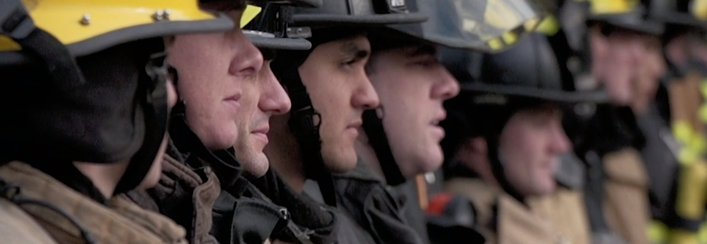


Thank You
For more information contact:
L-2 Board – Tammy or Jessica
Local Assistance Support Team
WSCFF

